Slide 1
The Third
Automated Negotiating
Agent Competition
4th July 2012

Slide 2
Background
Started in 2010, as a joint project of the universities of Delft (group of Prof. Catholijn Jonker, Dr. Koen Hindriks, Dr. Dmytro Tykhonov, Tim Baarslag) and Bar-Ilan (Prof. Sarit Kraus, Dr. Raz Lin)
In 2011, organised by Nagoya Institute of Technology (Prof. Takayuki Ito, Dr. Katsuhide Fujita)
In 2012, organised by University of Southampton (Colin Williams, Dr. Valentin Robu, Dr. Enrico Gerding, Prof. Nick Jennings)
Aim: to provide a platform to compare and benchmark different state-of the-art heuristics developed for automated, bilateral negotiation

Slide 3
Competition Setup
Bi-lateral Negotiation
Alternating Offers Protocol
Real-time, 3-Minute Deadline
Discounting Factor

Slide 4
Domains and Preferences
Each domain consists of pair of preference profiles.
Each preference profile specified as linearly additive utility function.
Between 1 and 8 issues.
Domains with between 3 and 390,625 possible outcomes.

Slide 5
Example Domain
Property Rental
  Rent Price per month
    $1,800, $2,000, $2,400, $2,700
  Number of Payments
    1, 2, 3
  Advance Payment
    0.5%, 1%, 2%, 2.5%
  Contract Period
    3 months, 6 months, 9 months, 12 months

Slide 6
Example Preferences
Rent Price per month | Landlord | Tenant
weight | 0.350 | 0.353
$1,800 | 20 | 80
$2,000 | 40 | 60
$2,400 | 60 | 40
$2,700 | 80 | 10
Number of Payments | Landlord | Tenant
weight | 0.2 | 0.129
1 | 20 | 5
2 | 15 | 8
3 | 10 | 12

Slide 7
Previous Competitions
2010
  7 Entries
2011
  18 Entries (6 institutions)
2012
  17 Entries (8 institutions)

Slide 8
New Feature
Reservation Value
  Utility of conflict, which each party receives if no agreement is formed.
  Affected by discounting factor.

Slide 9
Participants
17 Teams Entered
8 Institutions
5 Countries
  China, Israel, Netherlands, Japan, United Kingdom

Slide 10
Qualifying Round

Slide 11
Qualifying Round
Negotiations carried out for every combination of:
  17 Agents
  17 Opponents
  18 Domains
    (17 submitted this year, plus Travel from 2010)
Each repeated 10 times to establish statistical significance.
Total of 52020 negotiations.

Slide 12
Qualifying Round - Rankings
Welch’s T-test for statistical significance
  Extension of Student’s T-test
All i, j in A, compute w(μ_{i}, σ_{i}, μ_{j}, σ_{j})
Determine lower bound on rank by calculating how many opponents beat the agent.
Determine upper bound on rank by calculating how many opponents the agent beats.
Notes:
Welch’s T-test designed for comparing two samples where the variances differ.

Slide 13
Qualifying Round - Rankings
Rank | Agent | Mean Score | Variance
1-2 | CUHKAgent | 0.597 | 0.000058
1-2 | OMACagent | 0.590 | 0.000106
3-5 | TheNegotiator Reloaded | 0.572 | 0.000073
3-7 | BRAMAgent2 | 0.568 | 0.000045
3-7 | Meta-Agent | 0.565 | 0.000104
4-7 | IAMhaggler2012 | 0.564 | 0.000029
4-8 | AgentMR | 0.563 | 0.000136
7-9 | IAMcrazyHaggler2012 | 0.556 | 0.000016
8-10 | AgentLG | 0.550 | 0.000090
9-11 | AgentLinear | 0.547 | 0.000071
10-11 | Rumba | 0.542 | 0.000064
12 | Dread Pirate Roberts | 0.521 | 0.000068
13-14 | AgentX | 0.469 | 0.000034
13-14 | AgentI | 0.465 | 0.000071
15-16 | AgentNS | 0.455 | 0.000063
15-16 | AgentMZ | 0.447 | 0.000064
17 | AgentYTY | 0.394 | 0.000018

Slide 14
Qualifying Round - Rankings
Rank | Agent | Mean Score | Variance
1-2 | CUHKAgent | 0.597 | 0.000058
1-2 | OMACagent | 0.590 | 0.000106
3-5 | TheNegotiator Reloaded | 0.572 | 0.000073
3-7 | BRAMAgent2 | 0.568 | 0.000045
3-7 | Meta-Agent | 0.565 | 0.000104
4-7 | IAMhaggler2012 | 0.564 | 0.000029
4-8 | AgentMR | 0.563 | 0.000136
7-9 | IAMcrazyHaggler2012 | 0.556 | 0.000016
8-10 | AgentLG | 0.550 | 0.000090
9-11 | AgentLinear | 0.547 | 0.000071
10-11 | Rumba | 0.542 | 0.000064
12 | Dread Pirate Roberts | 0.521 | 0.000068
13-14 | AgentX | 0.469 | 0.000034
13-14 | AgentI | 0.465 | 0.000071
15-16 | AgentNS | 0.455 | 0.000063
15-16 | AgentMZ | 0.447 | 0.000064
17 | AgentYTY | 0.394 | 0.000018

Slide 15
Qualifying Round - Rankings
Rank | Agent | Mean Score | Variance
1-2 | CUHKAgent | 0.597 | 0.000058
1-2 | OMACagent | 0.590 | 0.000106
3-5 | TheNegotiator Reloaded | 0.572 | 0.000073
3-7 | BRAMAgent2 | 0.568 | 0.000045
3-7 | Meta-Agent | 0.565 | 0.000104
4-7 | IAMhaggler2012 | 0.564 | 0.000029
4-8 | AgentMR | 0.563 | 0.000136
7-9 | IAMcrazyHaggler2012 | 0.556 | 0.000016
8-10 | AgentLG | 0.550 | 0.000090
9-11 | AgentLinear | 0.547 | 0.000071
10-11 | Rumba | 0.542 | 0.000064
12 | Dread Pirate Roberts | 0.521 | 0.000068
13-14 | AgentX | 0.469 | 0.000034
13-14 | AgentI | 0.465 | 0.000071
15-16 | AgentNS | 0.455 | 0.000063
15-16 | AgentMZ | 0.447 | 0.000064
17 | AgentYTY | 0.394 | 0.000018

Slide 16
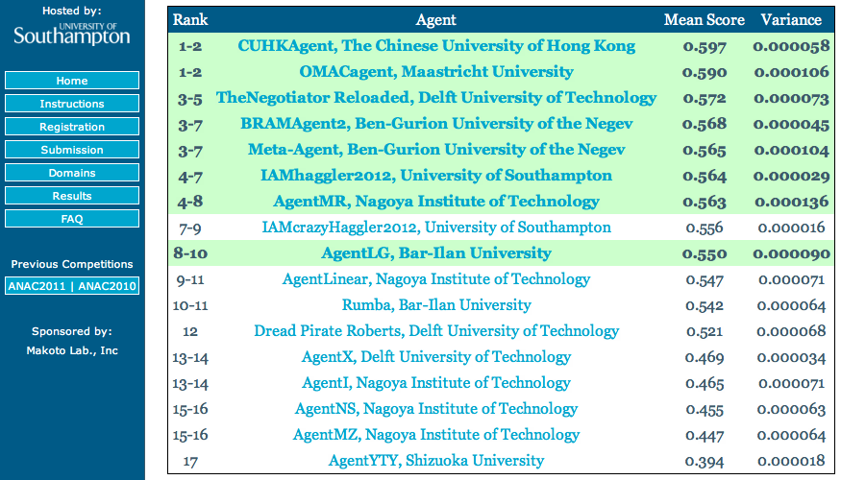
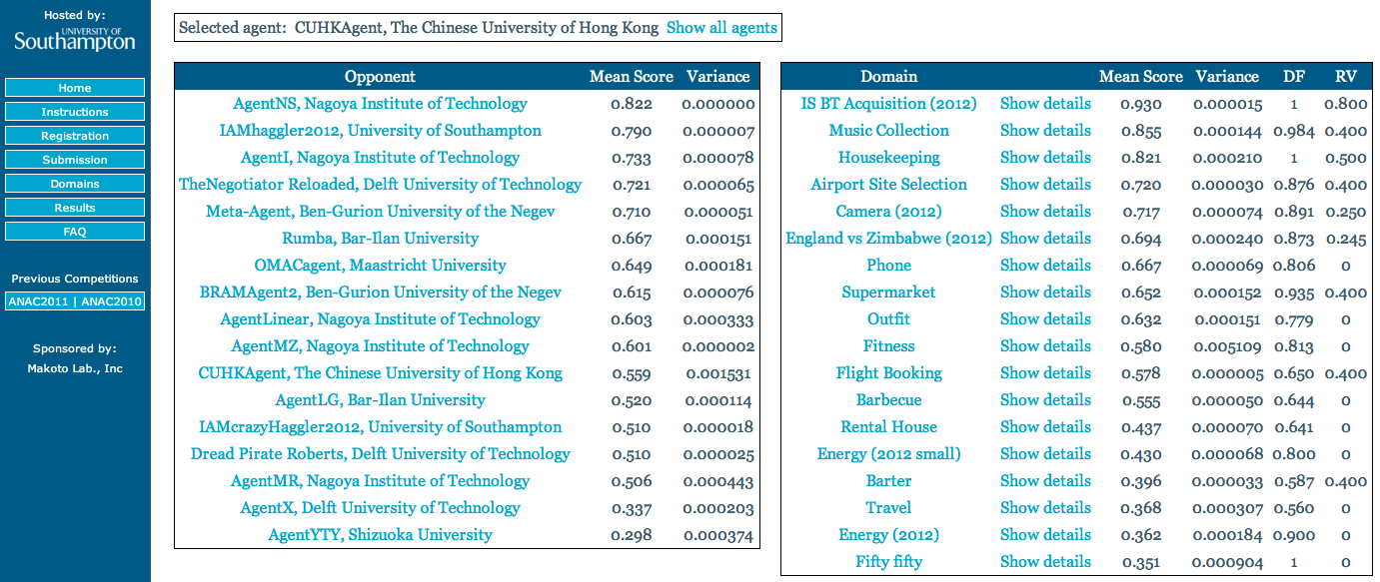
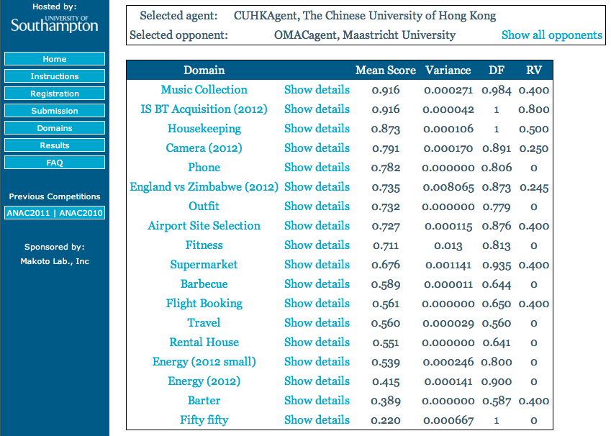
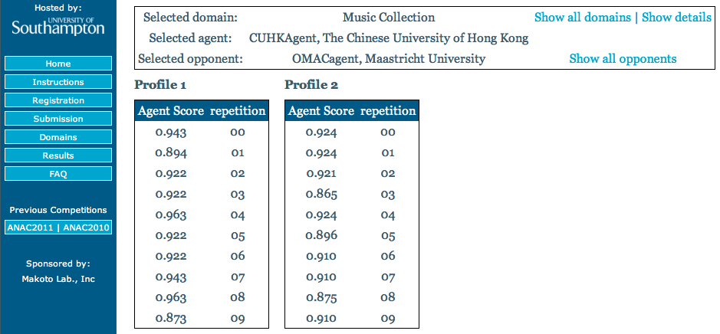
Qualifying Round - Rankings
http://anac2012.ecs.soton.ac.uk

Slide 17
Qualifying Round

Slide 18
Agent Presentations
Notes:
Each finalist team will now briefly present their strategies.

Slide 19

AgentLG
Bar-Ilan University
Luba Golosman
(presented by Assaf Frieder)

Slide 20
First Stage
0.0 - 0.6 of the total time
  Bids are offered in order of agent’s utility until the lower bound
  Decrease threshold based on discount factor
  Up to 25% of the difference between first bids
  Learn opponent’s preference profile

Slide 21
Second Stage
0.6 - 0.9 of the total time
  Estimate opponent’s compromise based on utility profile
  Decrease threshold based on opponent’s compromise and utility profile

Slide 22
Last Stages
Time 0.9- 0.9995 :
  Maximal compromise is half of the utility difference
Time >0.9995:
  Offers opponent’s best bid if higher than the reserve value
Acceptance:
  Opponent’s bid utility is higher than 99% of the agent’s bid
  After 0.999 of time, 90% of the agent’s bid utility

Slide 23
AgentMR
Nagoya Institute of Technology
Shota Morii
AgentMR has the following features:
Concedes slowly
Makes “acceptable” bids
Notes:
Hello, everyone.
My name is Shouta Morii from Nagoya Institute of Technology.
Today, I’d like to talk about our agent strategy.
AgentMR has the following features.
“Concede slowly” and “Make acceptable bids”

Slide 24
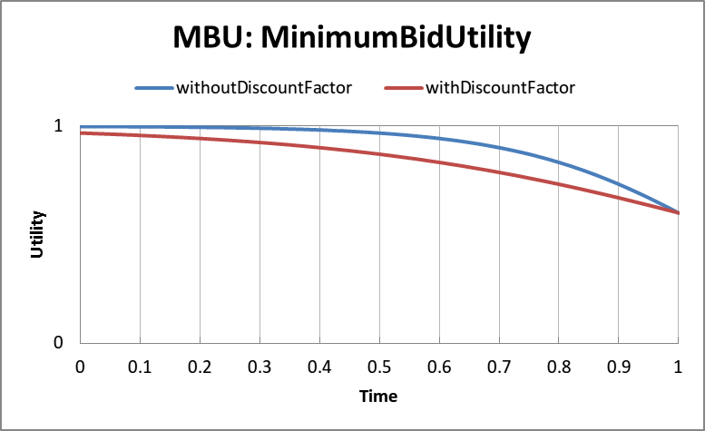
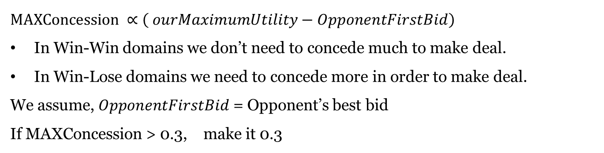
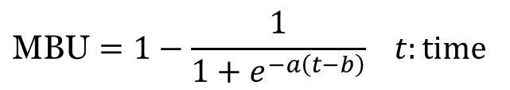
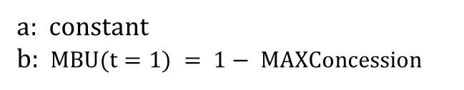
Concede slowly
MBU is threshold value.
Our bid > MBU
$$\text{MBU}=1−\frac{1}{1+e^{−a\left(t−b\right)}} t:time$$
MAXConcession
a: constant
b: $MBU(t=1) = 1− MAXConcession$
$$\text{MAXConcession} ∝\left( ourMaximumUtility−OpponentFirstBid\right)$$
In Win-Win domains we don’t need to concede much to make deal.
In Win-Lose domains we need to concede more in order to make deal.
We assume, $OpponentFirstBid$ = Opponent’s best bid
If MAXConcession > 0.3, make it 0.3
Notes:
First, I would like to talk about our concession strategy.
We concede slowly using sigmoid based function.
MBU is an abbreviation for MinimumBidUtility. MBU is threshold value.
Our bid will always have utility greater than the current MBU.
We always make sure that MBU value will not be less than Reservation Value.
The sigmoid function has a desirable property .
Initially it decreases very slowly.
But towards the end of negotiation it decreases at a faster rate to the MaxConcession point.
This property enables us to implement our strategy.
/*Which is initially to wait for the opponent in order to see how much it will concede
but towards the end of time concede faster in order to make deal. */
If there is a discount factor we concede faster by adjusting parameters of the sigmoid function.
The maximum concession is proportional to the difference our maximum utility and opponents maximum utility.
We assume that opponent’s first bid is his maximum bid.
The reason for this is that,
In Win-Win domains we don’t need to concede much to make deal.
In fact we need to be careful not to concede too much and get lower utility than the opponent.
But in Win-Lose domains we need to concede more in order to make deal.
When MAXConcession becomes greater than 0.3 we use the value 0.3 instead.
This corresponds to a utility value of 0.7 for us.
That is in the worst case we make deals which have utility of 0.7 for us.
We expect that on average this utility will be greater what our opponent gets.
Hence we expect overall to get high score in the competition.

Slide 25
Make ‘acceptable’ bid
Heuristic
Bids “similar” to opponent bid have high utility for the opponent
and hence are more ‘acceptable’ .
Opponent bid
OS | Display | HDD | Mem | Utility
Mac | 22 | 320GB | 2GB | 75%
Generate “Similar” bids by changing only one issue value at a time
My bid
OS | Display | HDD | Mem | Utility
Mac | 22 | 320GB | 4GB | 80%
Notes:
Second, I'll focus on the method of generating bid.
To increase the chance of getting agreement , we want to choose the bid which has also high utility for the opponent.
We use the heuristic that bids similar to opponent bid have high utility for the opponent (and hence are more acceptable).
We generate this similar bids by starting with the opponent bid changing one issue value at a time.
From these we choose the one with maximum utility.
In the figure a similar bid is generated by changing the value of one issue.
The value for memory was changed from 2GB to 4GB.

Slide 26
Make ‘acceptable’ bid
Bid1 and Bid2 have utility grater than MBU
The circle region represents location of bids which are close to AgentX’s recent bid
Since Bid2 is in this region we choose to offer it to AgentX
AgentMR’s
Utility
AgentMR
×
Bid
Bid1
Bid2
MBU
AgentX
AgentX’s
Utility
Generally our strategy is to concede slowly
and make bids which are acceptable.
Notes:
---- Anime ---
For example in this scenario our agent has two bids Bid 1 and Bid 2 which have utility greater than MBU.
The circle region represents location of bids which are close to AgentX’s recent bid.
Since Bid 2 is in these region we choose to offer it to AgentX.
it would be easy to obtain an agreement.
To conclude, generally our strategy is to concede slowly and make bids which are acceptable.
Thank you very much for your attention.
-----------------------------------------
Thank you for asking a quedtion.
That is a good point.
Can you please your question more slowly?
Are you asking about ***?

Slide 27
BRAMAgent2
Department of Information Systems Engineering
and
Deutsche Telekom Laboratories
Ben-Gurion University of the Negev, Beer-Sheva, Israel
Radmila Fishel, Maya Bercovitch

Slide 28
BRAM’s Characteristics
Simple and fast
Compromise as time elapses
Interrupt modeling attempts by other
Seek a
Win-Win agreement
Simple and fast
Compromise as time elapses
Interrupt modeling attempts by other
Seek a
Win-Win agreement

Slide 29

Seek a Win-Win Agreement
BRAM creates a histogram for each issue according to the last 10 offers received from the other agent and create a new offer with as many “top required” values as possible

Slide 30
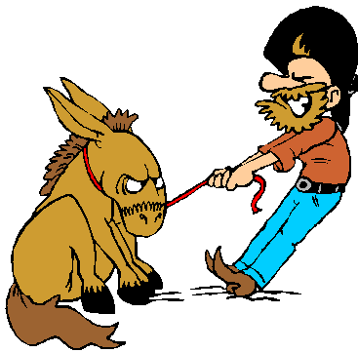
Improved Version of BRAM
BRAM ends the negotiation if it is willing to offer a bid with utility lower than the reservation value
BRAM is more tough and stubborn

Slide 31
Thank you!
BercovitchMaya@gmail.com
Rada.fishel@gmail.com

Slide 32
CUHKAgent
The Chinese University of Hong Kong
Jianye Hao, Ho-fung Leung

Slide 33
Strategy Design
Current negotiation history, domain, and time t
Acceptance-Threshold (AT)
Next-Bid (NB)
Acceptance-Condition (AC)
Termination-Condition (TC)
Produce the final
move

Slide 34
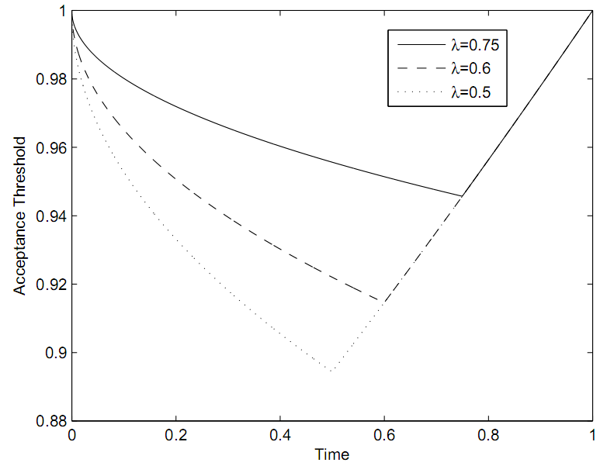
Component Description
Acceptance-Threshold (AT) component
  Non-exploitation point
  Adaptively adjusting Non-exploitation point
    Domain-dependent, e.g., discount factor, domain size.
    Behavior-dependent, e.g., Concession degree of the opponent

Slide 35
Component Description (cont.)
Next-Bid (NB) component
  Select the estimated best one for opponent from the set of candidate negotiation outcomes
Acceptance-Condition (AC) component
  Acceptance conditions
    Our agent’s utility of the opponent’s offer > our acceptance threshold
    OR
    Our agent’s utility of the opponent’s offer >its utility of our offer to be proposed
Termination-Condition (TC) component
  Treating the reservation value simply as an alternative offer proposed by the opponent
  Termination conditions

Slide 36
Thank you!
Q&A

Slide 37
IAMhaggler2012
University of Southampton
Colin R Williams, Valentin Robu,
Enrico H Gerding, Nicholas R Jennings

Slide 38
Our Approach
Principled, decision-theoretic approach
  Sets behaviour as best response to negotiation environment and opponent behaviour.
Considers
  The discounting factor
  The remaining time
  The effect of the opponent’s future concession on our utility

Slide 39
Gaussian Process Regression
Use a Gaussian process regression technique in an attempt to learn the opponent’s concession.
  Mean prediction
  Confidence measure
Set concession rate according to this prediction.

Slide 40
Gaussian Process Regression
Use a Gaussian process regression technique in an attempt to learn the opponent’s concession.
Observed data points at time t_{c}

Slide 41
Gaussian Process Regression
Predict future concession by opponent.
mean prediction
95% confidence
interval
Completed Gaussian Process Regression (showing mean and 95% confidence interval)

Slide 42
Maximise Expected Utility
Apply discounting to determine expected discounted utility of our opponent’s offer at time t.
Expected discounted
utility

Slide 43
Maximise Expected Utility
Find the time, t*, at which expected discounted utility of our opponent’s offer is maximised.
time at which expected discounted utility is maximised

Slide 44
Maximise Expected Utility
Find the best utility, u* to offer at time t*
P(U(o) > u)
probability of offer
being accepted
Notes:
Aim is to maximise the expected discounted utility of our offer.

Slide 45
Maximise Expected Utility
Find the best utility, u* to offer at time t*
P(U(o) > u)
E(u)
probability of offer
being accepted
[t*, u*]
expected utility of proposing offer

Slide 46
Choose Target Utility
Concede towards [t*, u*].
P(U(o) > u)
E(u)
[t*, u*]

Slide 47
Choose Target Utility
Concede towards [t*, u*].
P(U(o) > u)
E(u)

Slide 48
Choose Target Utility
Concede towards [t*, u*].
P(U(o) > u)
E(u)

Slide 49
Dealing with Multiple Issues
Select a random package, with utility close to target (according to concession strategy).
  Fast process allows many offers to be made.
  Encourages exploration of outcome space.

Slide 50

Meta-Agent
Ben-Gurion University of the Negev
Litan Ilany, Ya’akov (Kobi) Gal
AI@BGU

Slide 51


Not a regular agent…
Based on “Wisdom of the Crowd” theory.
Combined all publicly available ANAC 2011 strategies.
Not a single line of strategic code.
(except reservation-value adding)
AI@BGU

Slide 52
Methodology
Used publicly available ANAC qualifying results as training set.
Used Linear Regression to predict the best agent.
Designed Meta agent that chooses the best agent for each role in each domain.
AI@BGU

Slide 53
OMACagent
Maastricht University, The Netherlands
Siqi Chen, Gerhard Weiss

Slide 54
Introduction
OMAC = “Opponent Modeling + Adaptive Concession-making”
OMACagent = a basic implementation of OMAC
Following two slides about the two main components (OM + AC)

Slide 55
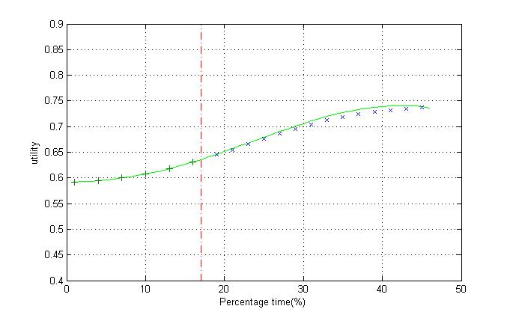
Modeling opponent's negotiation strategy
Discrete wavelet transform (DWT)
Cubic smoothing spline

Slide 56
Adaptive concession-making mechanism
Estimation function of future opponent concession
Dynamic conservative utility function

Slide 57
TheNegotiator Reloaded
Delft University of Technology
Mark Hendrikx, Alex Dirkzwager

Slide 58
Contents
BOA Framework
Implementation BOA Components
  Bidding strategy
  Acceptance Strategy
Optimization of Agent
Conclusion

Slide 59
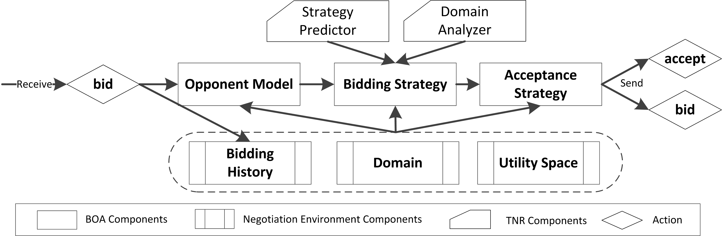
BOA Framework
Baarslag, T.; Hindriks, K.; Hendrikx, M.; Dirkzwager, A. & Jonker, C.
Decoupling Negotiating Agents to Explore the Space of Negotiation Strategies

Slide 60
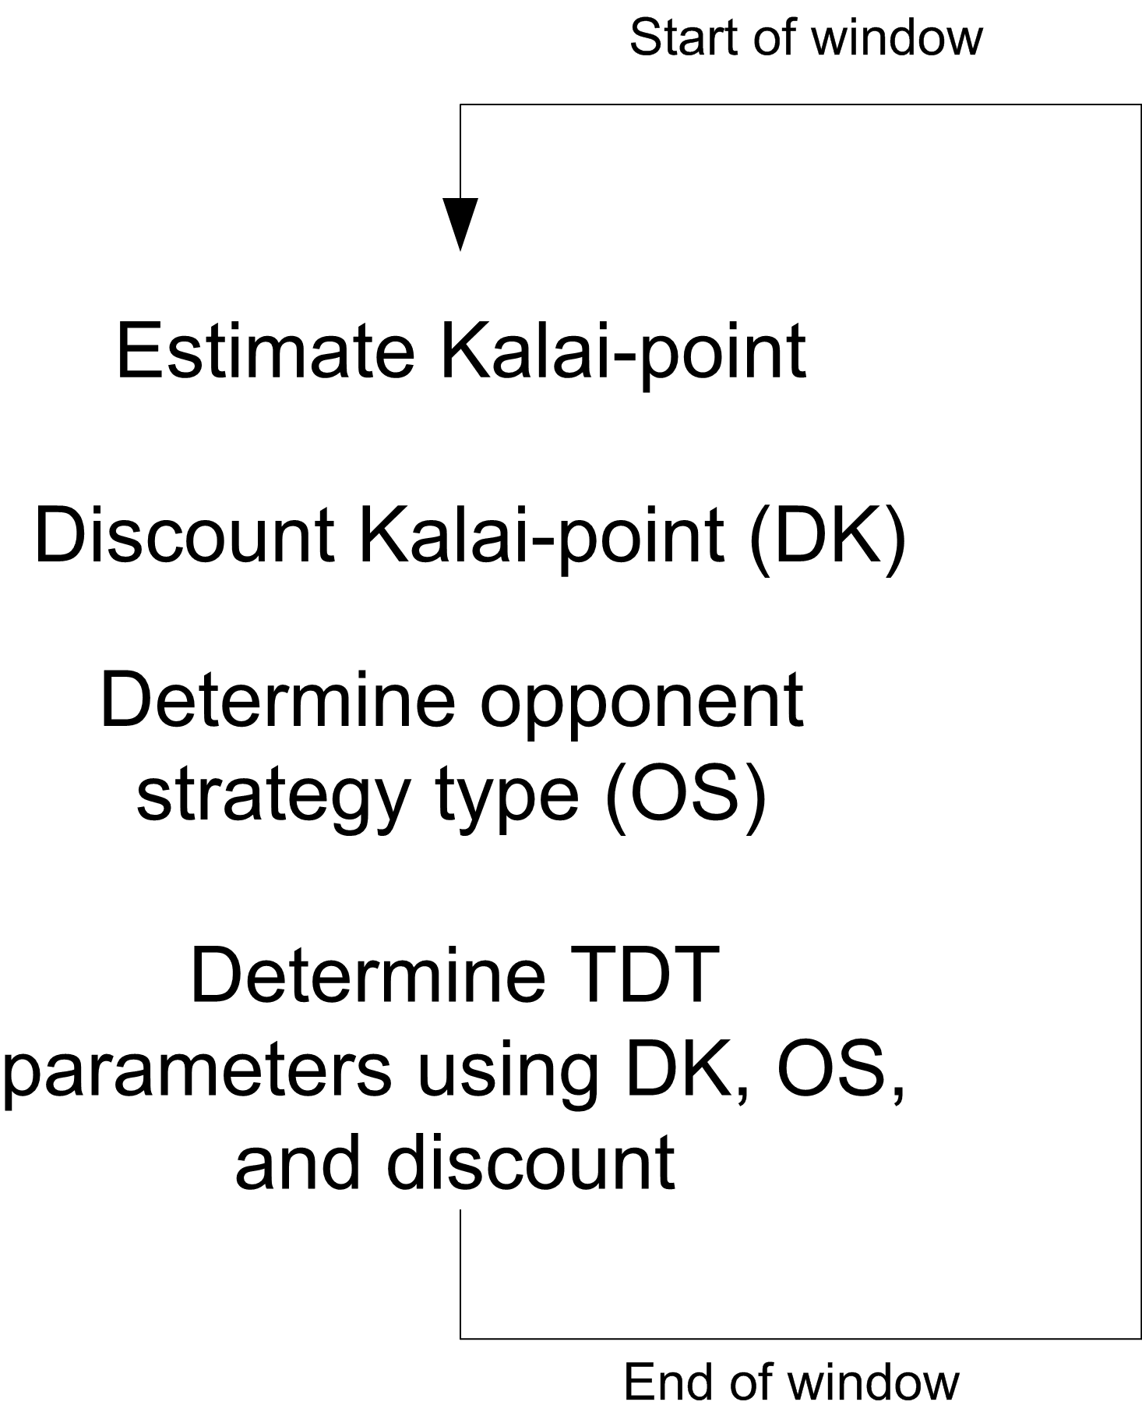
Implementation BOA Components
Bidding Strategy

Slide 61
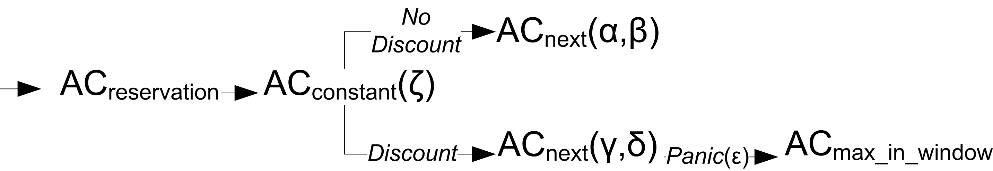
Implementation BOA Components
Acceptance Strategy

Slide 62
Optimization of Agent
Basic components → Database of BOA
Bidding strategy → Distributed Genius
Opponent model → Model analyzer of BOA
Acceptance condition → MAC of BOA

Slide 63
Conclusion
First ANAC agent using the BOA framework
Optimized using new methods
Dynamic domain- and opponent-based strategy

Slide 64
Final Round

Slide 65
Final Round
8 Agents
8 Opponents
24 Base Domains
    (17 submitted this year, 5 from 2011, 2 from 2010)
3 Discounting factors:
    1.00, 0.75, 0.50
3 Reservation values:
    0.00, 0.25, 0.50

Slide 66
Final Round
24 base domains of varying size
Split into small, medium, large.
Notes:
Latin Square

Slide 67
Final Round
From each base domain, generated three domains with different values of df and rv
  These three domains covered all three values of df and all three values rv.
 |  | rv
 |  | 0.00 | 0.25 | 0.50
df | 1.00 | S | M | L
 | 0.75 | L | S | M
 | 0.50 | M | L | S
Notes:
Latin Square

Slide 68
Final Round
8 Agents
8 Opponents
72 Domains
Entire setup repeated 10 times to establish statistical significance.
Total of 46080 negotiations.

Slide 69
Prizes
1st Place | $500
2nd Place | $400
3rd Place | $300
Best in Discounted Domains | $100
Best in Undiscounted Domains | $100
Most Social Agent | $100
With thanks to our sponsors:
Prof. Dr. Catholijn Jonker
Prof. Dr. Sarit Kraus
Prof. Dr. Takayuki Ito / Makoto Lab., Inc.

Slide 70
Overall Rankings
Agent which achieves best average score across all domains.

Slide 71
Overall Rankings
Agent which achieves best average score across all domains.
Notes:
Top 4 agents achieved very similar utilities. Only 0.01 difference between top 4.
3rd and 4th ranked are so close that the difference is not statistically significant
as shown by t-test.

Slide 72
3rd Place
3rd
0.618
OMACagent
Maastricht University
Siqi Chen, Gerhard Weiss
and
TheNegotiator Reloaded
Delft University of Technology
Mark Hendrikx, Alex Dirkzwager
0.617

Slide 73
2nd Place
2nd
AgentLG
Bar-Ilan University
Luba Golosman
0.622

Slide 74
1st Place
1st
CUHKAgent
The Chinese University of Hong Kong
Jianye Hao, Ho-fung Leung
0.626

Slide 75
Overall Rankings
Agent which achieves best average score across all domains.

Slide 76
Best in Discounted Domains
Agent which achieves best average score over discounted domains.

Slide 77
Best in Undiscounted Domains
Agent which achieves best average score over undiscounted domains.

Slide 78
Most Social Agent
Agent which maximises the sum of its own utility and its opponent’s.

Slide 79
Agent vs Opponent
CUHKAgent
IAMhaggler2012

Slide 80
Compared to ANAC2011
Considering only domains with zero reservation value.

Slide 81
Compared to ANAC2011
Considering only domains with zero reservation value.

