Slide 1
Screen-printed multilayer meander heater
on polyester cotton
Russel Torah*, Kai Yang, Steve Beeby, John Tudor
University of Southampton
Electronics and Computer Science
United Kingdom
{rnt*, ky2, spb, mjt}@ecs.soton.ac.uk

Slide 2
Outline of the Talk
Introduction
Screen printing to create smart fabrics
Design of screen printed heater
Material selection
Printing and processing
Measurement and testing
Conclusions and further work

Slide 3
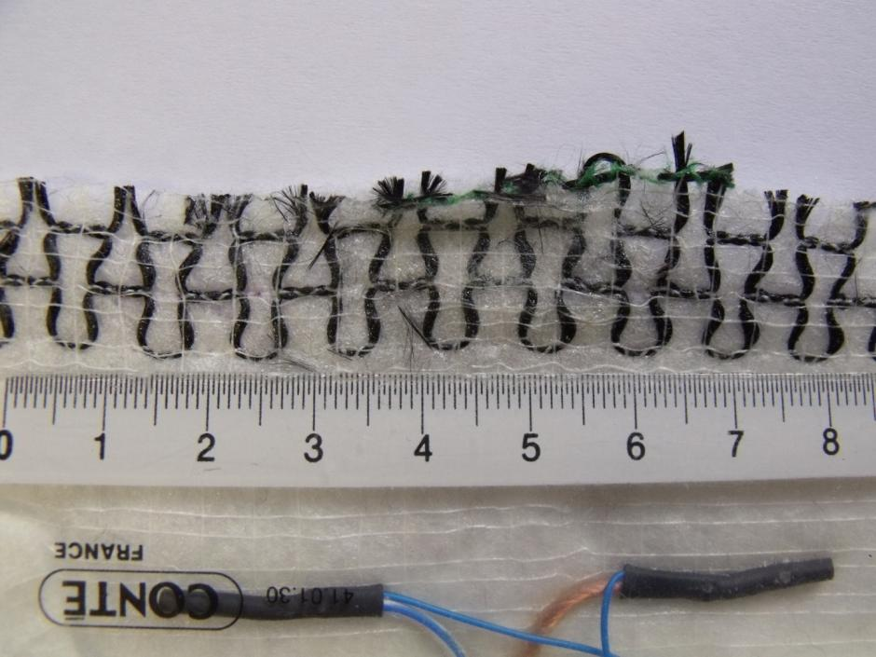
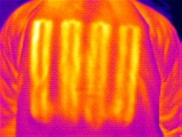
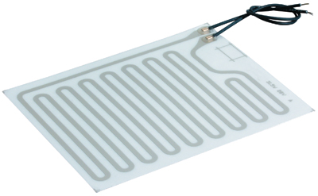
Introduction
Basic heater is a wire with a current passing through.
Heaters have widespread use in automotive fabrics and are becoming more popular for use in garments.
Current range of heaters are integrated into the textile using weaving or knitting.
The heater design is limited by the warp and weft use for the fabric construction or must be sown in using specialist equipment.
Heated Car Seat element BMW
www.bmw.com
Heated jacket
Gerbing Microwire
www.gerbing.com
Printed thick-film heating
element – Tempco
www.tempco.com

Slide 4
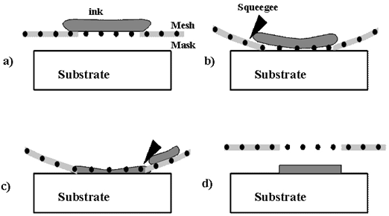
Screen Printing Smart Fabrics
Screen printing on fabrics has been used for over 1000 years, screen printing electronics on to solid circuit boards for 50 years.
A simple technique with widespread use in the fabrics industry.
Printable electronic pastes such as conductors, dielectrics, resistors and piezoelectric pastes now available at low temperatures (120-200 °C).
Fabrics require printed films which are very flexible and can be cured at low temperatures (<150 °C).
Screen printing process
DEK248 Screen printer used
at University of Southampton

Slide 5
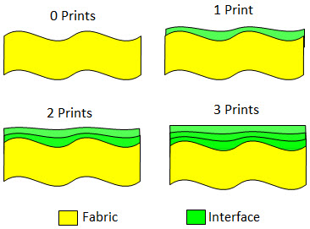
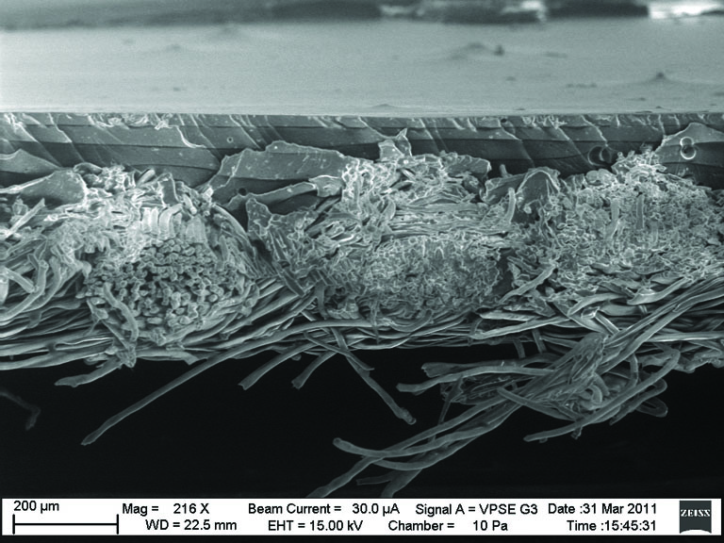
Screen Printing Smart Fabrics
Screen printable interface layer provides an intermediary between the fabric and the subsequent printed electronics and planarises the surface of the fabric.
The interface layer will fill in the weave of the fabric and reduce the surface roughness to provide a smooth surface for subsequent prints.
Interface layer
Fabric
Concept of a printed interface layer
Cross-section SEM micrograph of 4
screen printed interface layers on
polyester cotton fabric

Slide 6
Screen Printed Heater Design
Heater printed on a fabric area of 10x10cm.
Heater should be flexible and maintain the properties of the fabric as much as possible.
Chosen track width of 1mm for good compromise between conduction and flexibility.
Heater area coverage should be a maximum of 50% of the fabric.
Design Requirements | Value
Fabric size | 10 x 10 cm
Fabric border | 0.5 cm
Track width | 1mm
Heater area | <50% of fabric

Slide 7
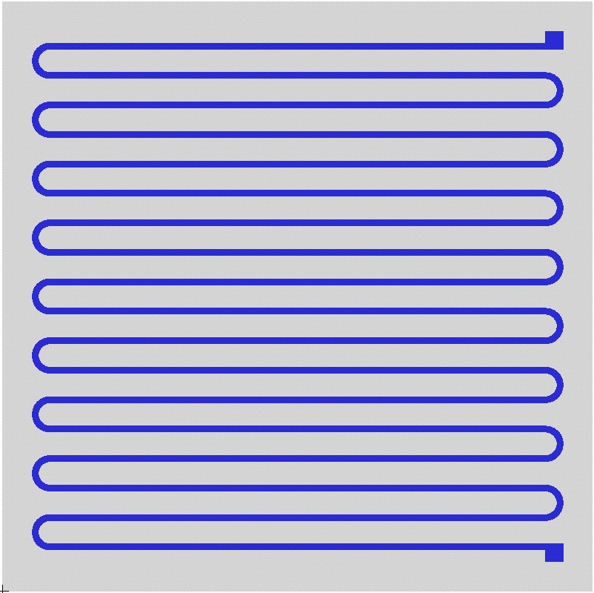
Heater design
100 mm
1 mm track width.
Total track length of 1651.5 mm.
Total area coverage for the heater = 1663.52 mm².
Percentage coverage = 20.5%
100 mm
4 mm
84 mm

Slide 8

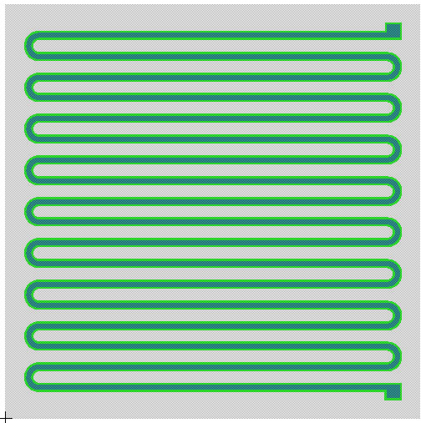

Screen Design
Heater has three layers: Interface, Conductor and Encapsulation.
Interface layer improves heater performance but does increase fabric coverage to ~40% - still below limit of 50%.
Encapsulation layer
Conductor layer
Interface layer
Fabric
10cm
Interface screen
Conductor screen
10cm
Complete design

Slide 9
Screen Printing
Polyester Cotton Fabric from Klopman International (klopman.com) is printed using DEK248 semi-automatic screen printer.
Interface is printed with 4 layers using Fabink-UV-IF1 (fabinks.com) directly on to the fabric and then UV cured for 30 seconds.
Silver layer is printed with 1 layer but 2 printer passes to reduce the chance of pinholes without using too much silver. UV cured for 8 minutes.
Encapsulation is printed with 2 layers using Fabink-UV-IF1, UV cured for 30 seconds.
Fabink-UV-IF1 has a dielectric strength of 7.5MV/m so provides good electrical as well as environmental isolation.

Slide 10

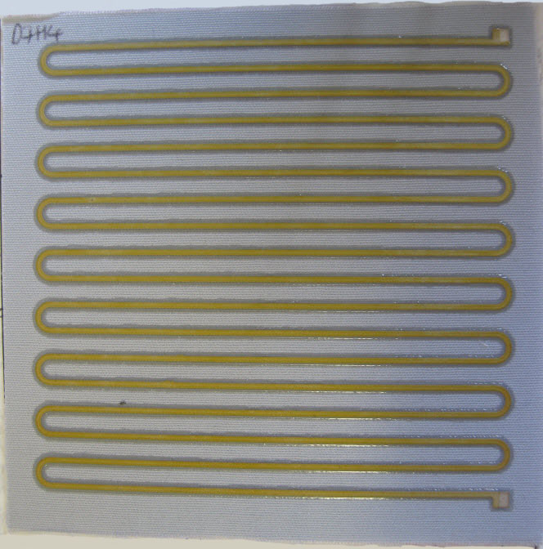

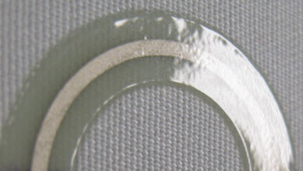
Screen Printing
Layers | Printed Thickness
Interface (Fabink-UV-IF1) | ~120 µm
Conductor (ELX 30UV) | ~7 µm
Encapsulation (Fabink-UV-IF1) | ~40 µm
Interface layer
Conductor layer
Encapsulation layer

Slide 11
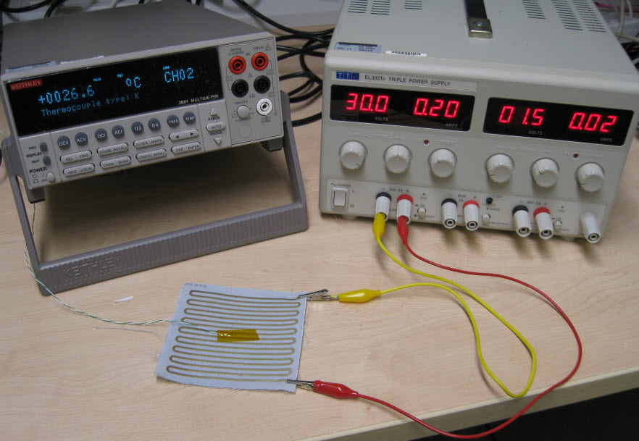
Measurement and Testing
Voltage is applied until the heater reaches the desired temperature then it is switched off and the heater allowed to cool.
Temperature is monitored throughout using a thermocouple.
Keithley
Multimeter
Power Supply
Heater +
Thermocouple
Test equipment setup for measuring the
temperature response of the printed heater

Slide 12
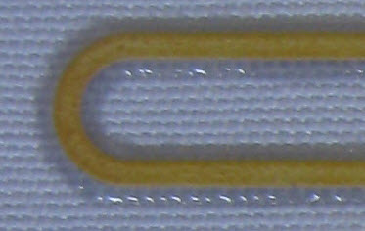
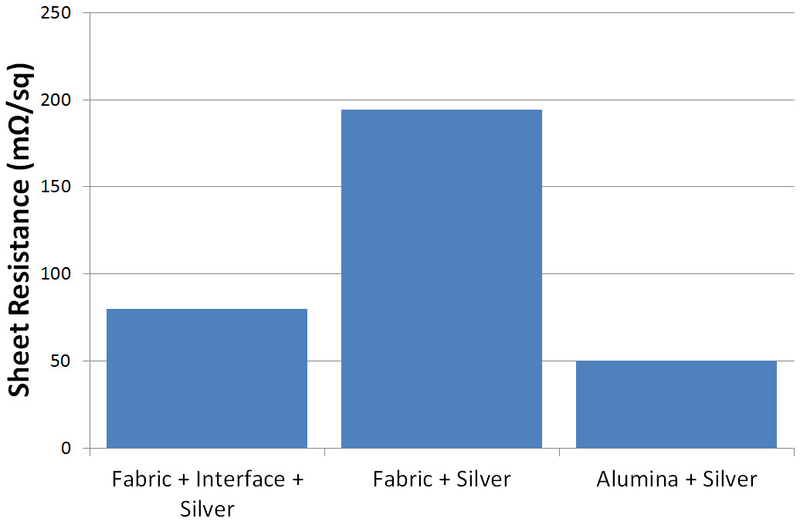
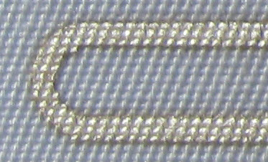
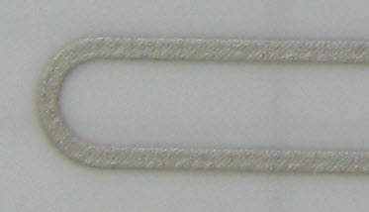
Results
Reduction in sheet resistance due to use of interface layer.
Confirms the function of the interface layer – provides a smoother more even surface than directly on fabric.
Interface
194 mΩ/sq
Fabric
80 mΩ/sq
50 mΩ/sq
Alumina
Printed track on each
substrate
Printed track calculated sheet resistance for each substrate

Slide 13
Results
The datasheet for UV curable silver gives a sheet resistance of 60 mΩ/sq.
Track resistance is reduced by over 50% when using the interface layer on fabric.
Sample | Track Resistance (Ω) | Sheet Resistance (mΩ/sq)
Theory | 99 | 60
Alumina | 83 | 50
Fabric | 321 | 80
Fabric + Interface | 132 | 194
Measured track resistance for each sample and calculated
sheet resistance based on track length of 1651.5mm.

Slide 14
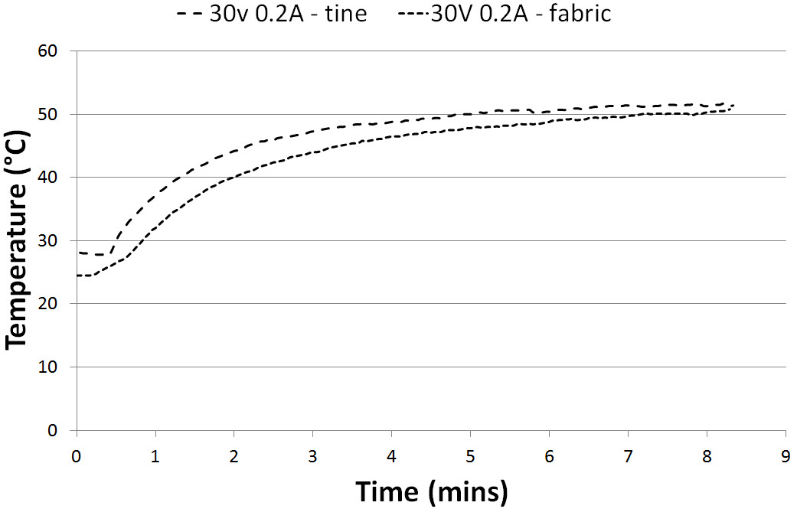
Results
Thermocouple on the tine and on the fabric.
Fabric temperature within 2% of track temperature.
50 °C heating achieved with 30 V and current limit of 200 mA

Slide 15
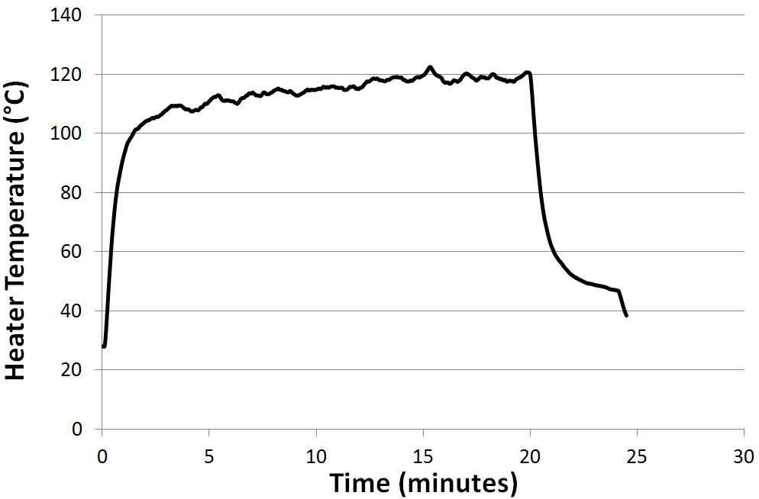
Results
Thermocouple attached to the fabric.
30V applied to the heater with 600 mA current limit.
Heater reaches 120 °C after 15 minutes.

Slide 16
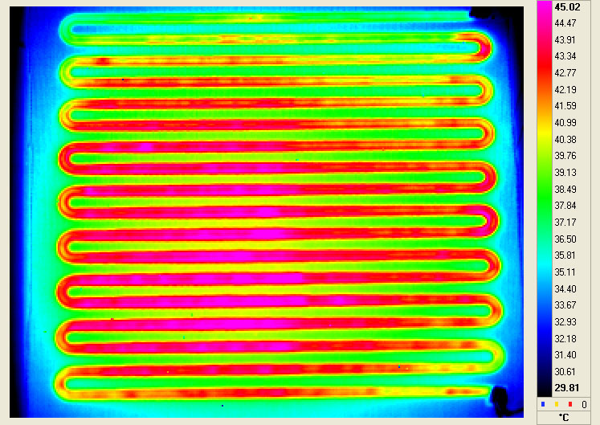
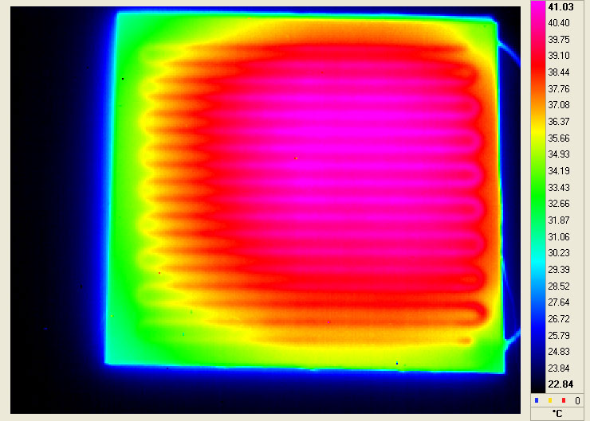
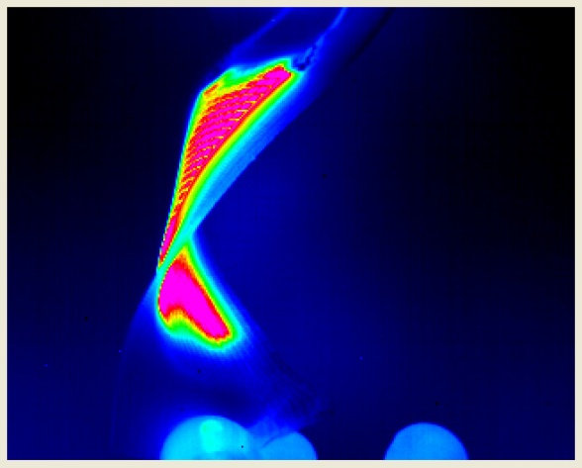
Resistive Heater Testing
A thermal imaging camera was used to obtain IR images of the heaters to observe the heat distribution.
Front of Polycotton heater
30s after voltage is applied
Back of Polycotton heater
30s after voltage is applied
Heater flexing whilst voltage is applied

Slide 17
Conclusions and Further work
Meander heater has been successfully screen printed on to polyester cotton fabric.
Printed heater has shown stable heating up to 120°C with a 30V power supply and a current limit of 600mA.
Heater pattern covers an area of 9cm x 9cm with a fairly even heat distribution and a track coverage of just 20%.
Low pattern percentage ensures fabric remains flexible and maintains key fabric properties such as breathability and wearer comfort.
Future work will try new designs to reduce the track resistance and improve the heater performance.
Smaller interface border will be investigated to improve flexibility by reducing fabric coverage.

Slide 18
Acknowledgements
The authors would like to thank the EU for supporting this work through the Framework 7 NMP Project – MICROFLEX: Grant No: CP-IP 211335-2.
Klopman for supplying the fabric – www.klopman.com
Fabinks for supplying the interface layer material www.fabinks.com
Thank you for listening!
Terima kasih kerana sudi mendengar!

