Slide 1

The English Language Skills Initiative for Employability Project (ELSIE):
The benefits of embedding employability into a core curriculum
(April 2011)
Angela Jayne Kilpatrick
ELSIE Employability Co-ordinator
(University of Central Lancashire)

Slide 2

Let’s talk about … ELSIE
The English Language Skills Initiative
for Employability
See http://www.elsieproject.org.uk
Notes:
We realise how employable English graduates are – and have made employability our core business, whilst not detracting from the discipline
Introduce myself – Former Student of English language and Linguistics at UCLan, graduated 2007, Research Assistant and Project Manager
ELSIE is a scheme that English language and linguistics students at the University of central Lancashire participate in – it has been embedded into the core curriculum

Slide 3
Content:
Introduction to ELSIE
Answering the why
Answering the how (of employability)
The ELSIE scheme
Assessing employability
The Benefits

Slide 4
ELSIE is …
… an innovative subject-specific employability scheme, developed at UCLan, which helps students to:
  Get the most out of their degree
  Reflect on their subject-specific and generic skills
  Learn how to transfer these skills to a ‘work’ context
  Research future career options throughout their degree and beyond

Slide 5
A description of …
Designed to help students improve their ENGLISH (in respect to knowledge and also usage)
Specific emphasis on LANGUAGE COMMUNICATION within a variety of settings (in particular, academic language and the language of the workplace)
A focus on transferable SKILLS
Our goal?
To see students “IMPROVE … IMPRESS … IMPACT”
For the ELSIE team, EMPLOYABILITY =
personal development and career planning via a combination of subject-specific knowledge, mentoring schemes and employability projects
E
L
S
I
E

Slide 6
The Impetus for ELSIE…
A globally changing society
Research carried out at UCLan which suggested that Humanities students felt ill-prepared for the workplace
English as a subject discipline being seen as non-vocational
Widening participation
Dearing report (1997) which emphasised the development of students’ key skills in HE
Employers seeking graduates with excellent communication skills
UCLan’s medium-term strategy
Notes:
1. As the world of work changes, bringing new opportunities, but demanding new approaches, the notion of a ‘graduate job’ and a linear career path are no longer realistic expectations for the 21st century graduate. Those leaving Higher Education in the next few years will be expected to engage with a diversity of work patterns, many working in smaller enterprises (SMEs), becoming self-employed or working on a freelance basis. The world economy is in crisis and graduates will need to be very flexible to maintain careers in the global economy.
Graduates will need a wide range of employability and enterprise knowledge, aptitudes and skills in order to take control of their careers, work effectively with others and add value to society and organisations in a short space of time.
2. Students were happy with their degree but said they would have liked more careers advice, found they had certain business skills lacking and would have liked more opportunities for work-based learning.
3. As opposed to disciplines like law and social sciences
4. Meaning that more graduates than ever before are entering the workforce and competing for skilled jobs – government 50% by 2012
6. A number of studies have been carried out which have asked employers to prioritise the skills that they see as most important in a graduate – communication skills nearly always come out top,
7. which places the development of student employability and enterprise at the heart of the university’s work

Slide 7
What is ‘employability’?
Employability can be thought of as ‘…a set of achievements, understandings and personal attributes that make individuals more likely to gain employment and be successful in their chosen occupations’
(ESECT 2005 based on a definition from Peter Sewell, UCLan).
For the ELSIE team, ‘employability’ is distinct from employment: it is a lifelong process where the individual’s knowledge, skills, capabilities, needs and/or desires are continuously being re-evaluated through a process of reflection.’
(Archer, Day and Kilpatrick 2008)
= lifelong learning

Slide 8
The S.E.E model shows the continual aspect of self awareness and employability (Kilpatrick 2008)
Notes:
Increasingly, having a degree does not guarantee students a graduate job – students need to be able to market themselves and the wealth of skills and attributes that they have developed and/or possess. Students not only need to possess certain qualities, they must have a good insight into what these qualities are and how they can be transferred from one context to another. To do this, students have to actively engage in the process of self reflection and evaluation. The S.E.E model, above, exemplifies one of the fundamental elements of the ELSIE course: the importance of self-awareness.

Slide 9
How do we “teach” employability?
SELF
AWARENESS
OPPORTUNITY AWARENESS
DECISION
LEARNING
TRANSITION LEARNING
Theoretical framework adapted from Law and Watts (1977) DOTS career model.
Notes:
Self awareness – look at learning styles Honey and Mumford. Personality types – Myer-Briggs type indicators. Use career profiling tools – prospects website. They begin to evaluate their skills, attributes and personal preferences and then apply these to how this may affect their studies, and career choices.

Slide 10
The ELSIE Scheme
EG1001English Language Workshop I
(compulsory for English Language Studies and Joint degree programmes – can be taken as an elective by other first years)
EG2000 English Language Workshop II
(compulsory for English Language Studies students – can be taken as an elective by other second years)
Certificate in Career Planning (for those undertaking a double dissertation in English Language/Linguistics)
Notes:
EG1001 – PDP, career planning, study skills/academic skills, employability – what it is and what it means to them, and communication skills oral/written.
EG2000 – continues to address PDP, academic/study skills, communication skills oral/written, but now they get the opportunity to put their communication skills, subject knowledge and transferable skills into practice by carrying out an employability project.
CCP – takes students through the process of making sure that their career choice is congruent with skills, personal attributes, motivations and values by using career profiling tools, such as the Prospects Planner, and psychometric testing (four tests) (this includes MBTI).
They are then asked to use decision strategies to help them make an informed career choice and then they apply for a job / further study and produce a tailored CV, and application form.

Slide 12
The Communication at Work project
Two aspects:
  How (verbal and written) communication works
  – in respect to grammar (= the nuts and bolts of communicating);
  internal structure (= cohesion, clarity);
  formality (= purpose);
  appropriacy (= target audience, politeness, cultural acceptability);
  tone (= “it’s not what we say, it’s the way that we say it!” adage)
  How different workplace environments will affect the language used
  = Bridging the perceived gap between academic study and the workplace

Slide 13


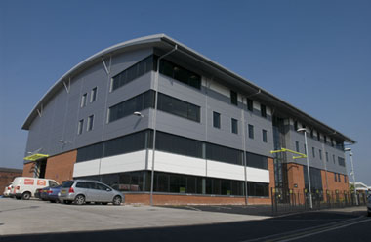



EG2000: The ‘Communication at Work’ Employability Projects
Recruitment & Training Solutions
Notes:
A number of new employers who have come on board for next year – Medequip for kids, TWL training agency (specialise in adult literacy), Duchess of Grange (an events management firm), to name a few.

Slide 14
Recent Projects
Events to raise local profile / money for the NSPCC and Medequip for Kids.
Working with a local homeless charity to raise its awareness in the Preston area.
Designing a website where students can publish their own literary work.
    The opportunities are endless…
    …. indeed, last year some of our (MA) students went to Kenya (to work on a phrasebook for Maa) …

Slide 15

Letters to Africa book (available on Amazon!)
Notes:
Letters to Africa book and photography by Photography, Publishing, Writing for Children, Sport Science, Children’s Illustration and Linguistics students from UCLan documenting the lives of children living in Zambia and Kenya.

Slide 16

How do we assess employability?
Reflective essays
PDP folder
Learning logs
Portfolio
Presentation
Helen Day’s Employability framework
http://www.uclan.ac.uk/information/uclan/employability/files/EF09marking_grid.pdf

Slide 17

Two models of ‘learning’
Make time to reflect…
EXPERIENCE
Plan to act differently
Reflect
Theorise
Based on Kolb’s Learning Cycle
Notes:
Assessment – highly reflective components. We ask the students to consider how their learning styles . Personality types have impacted on the project. What would they do differently next time – how will this help them in the future, in their future careers?

Slide 18
Two models of ‘learning’
CRISIS!
HOPE / FORGET
REACT (fire-fight)
BLAME
Avoid this model!!
Notes:
By giving students the opportunity to learn for themselves through a process of self-reflection – they find out firsthand about the difficulties they may encounter in the world of work.

Slide 19
Feedback from students…
‘People say it is useful to know our strengths and weaknesses; for me it's essential. ELSIE gives us an opportunity to realize which areas we need to improve in order to become more attractive to future employers and to make the most of our time at University.’ (Sebastian Kozbial)
‘ELSIE has helped me to develop skills that are both relevant for success in my academic studies, and transferable to the career I intend to enter once I have completed my degree. The ELSIE class helps to bring focus to future career prospects in a manner that has encouraged me to consider the importance of using my time at university to develop skills necessary to make me a stronger candidate for future prospective employers.’ (Bernadette Kavanagh)
‘The ELSIE module has been very beneficial. It has made me understand my potential, see what skills I already have and what skills I am able to gain.’ (Lisa Grigg: First Year Student)
‘ELSIE ‘…has inspired me to work harder and shown me that it is possible to achieve what you want […] there are a lot of opportunities out there and ELSIE shows us what we have to look forward to. It has also made me a lot more confident in myself.’ (Anonymous)
“ … making the implicit explicit …”

Slide 20
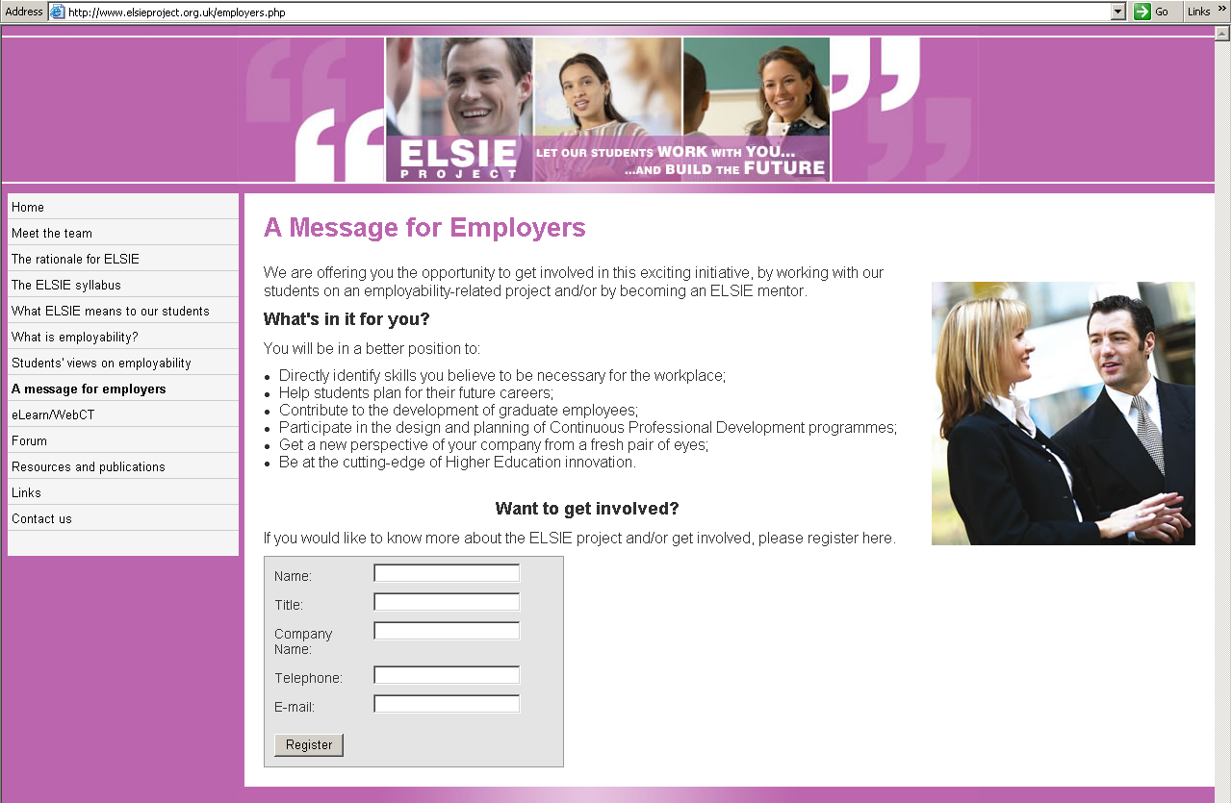
What’s in it for the employer?
Directly identify skills they believe to be necessary for the workplace
Help students plan for their future careers
Contribute to the development of graduate employees
Participate in the design and planning of
Continuous Professional Development programmes
Get a new perspective (re: their company) – from a fresh pair of eyes
Be at the cutting-edge of Higher Education innovation

Slide 21
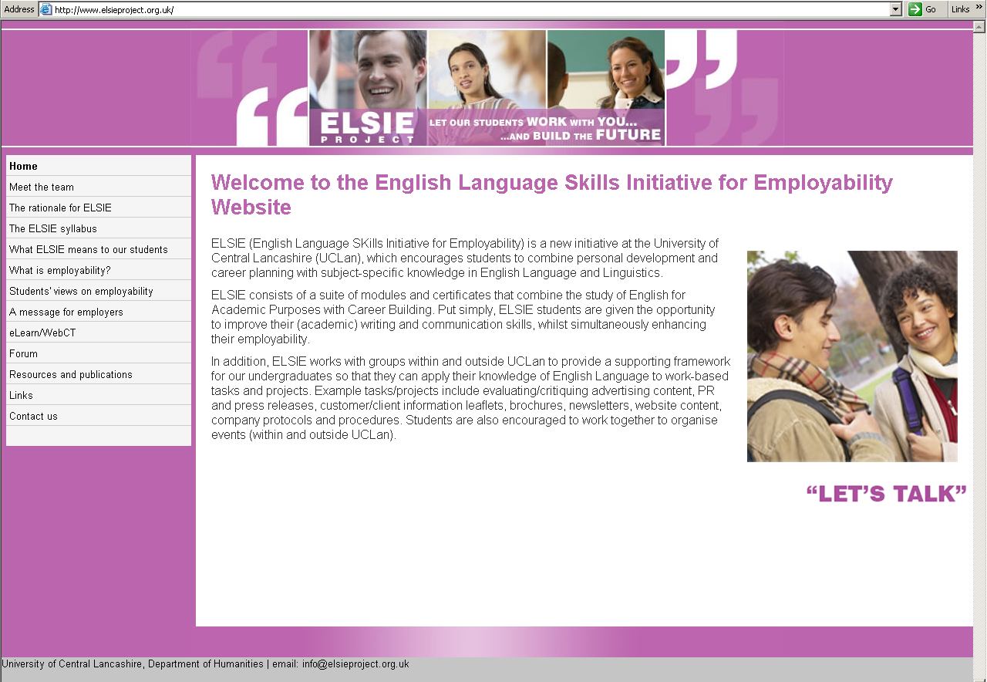

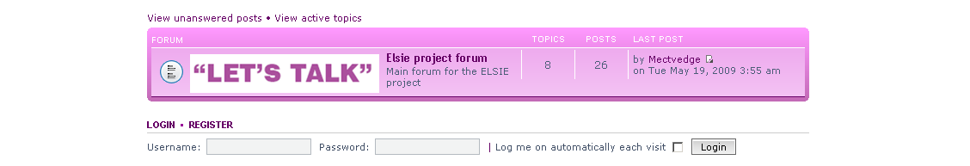
The ELSIE Website
http://www.elsieproject.org.uk/

Slide 22
To sum up…
“We give the students the tools to engage in lifelong learning and the opportunity to put theory into practice – allowing them to become autonomous learners”

Slide 23

Our ultimate goal for ELSIE students: that they go on to have sustainable, successful and satisfying careers
(built on a firm English-language foundation).
Notes:
Scott Colvin - head of public affairs for BAA British airports authority
Lancashire radio

