Slide 1
Key issues in vocabulary learning: developing intervention studies
Theory and Practice in Vocabulary Learning and Teaching
Institute of Education, 20th January 2012
Jeanine Treffers-Daller (Reading)

Slide 2
Setting the research agenda
Who decides?
The Haldane principle
The research agenda is being set almost entirely by the research community (Macaro 2003: 3)
Impact
Knowledge Exchange
Why is vocabulary important?
Notes:
the Haldane principle is the idea that decisions about what to spend research funds on should be made by researchers rather than politicians. It is named after Richard Burdon Haldane, who in 1904 and from 1909 to 1918 chaired committees and commissions which recommended this policy.

Slide 3
What do teachers find important?
Researchers may not necessarily be delving into the area that the teacher needs to inform his or her practice.
What kinds of research in MFL do teachers find most useful? (Macaro 2005)
1 = useful 4 = not at all useful
Notes:
3

Slide 4
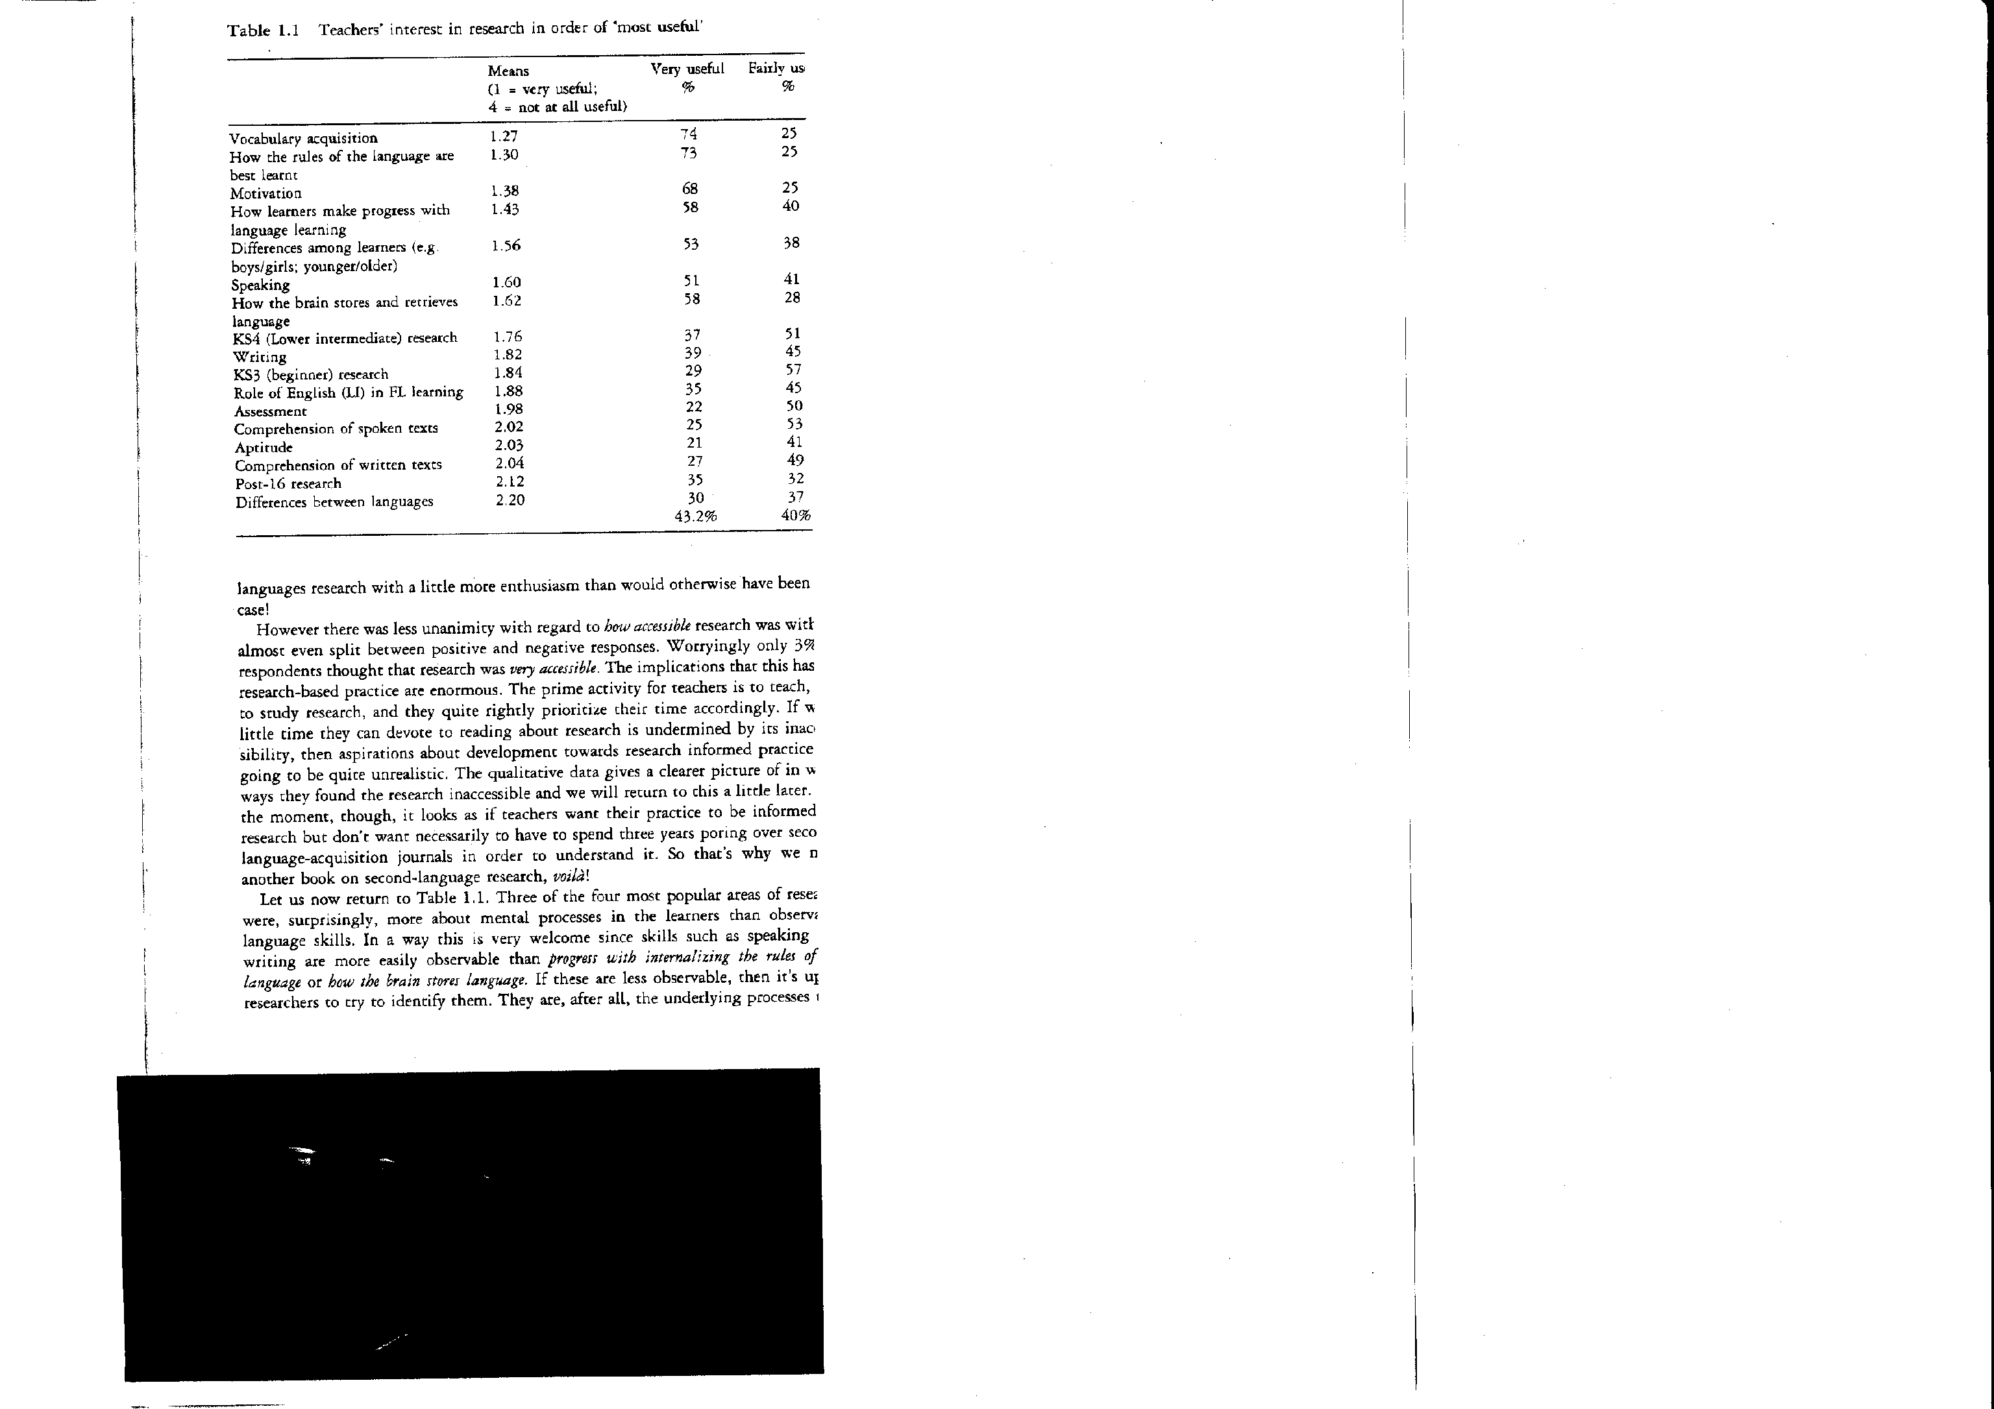
Macaro (2003)
N=80
Notes:
4

Slide 5
Vocabuild survey
What areas of speech, language and learning do you feel are most important when supporting a bilingual child? Rank in order of priority with 1 being the most important and 7 being the least important.
vocabulary | 1.73
social interaction | 2.10
sentence structure | 3.57
pronunciation | 4.74
phonics | 5.10
grammar | 5.22
literacy | 5.60
N =143 (21 June 2010)
Notes:
63% SLT, 42% teaching staff, 5% EMAS
5

Slide 6
Overview
Project 1: Vocabulary size (with Jim Milton)
  How many words do native speakers know?
  How is this linked to academic achievement/reading?
Project 2: How learnable are expressions of movement? (with Françoise Tidball)
Conclusion: towards intervention studies

Slide 7
Project 1: Vocabulary size
Does size matter?
How many words do adult native speakers know?
How is this related to academic achievement and reading habits?
Notes:
Work done with Jim Milton

Slide 8
Vocab size of native speakers
source | estimate
Kirkpatrick (1891) | 10,000 words (20-100k for graduates)
Seashore & Eckerson (1940) | 155,000 words
Hartmann (1946) | 200,000 words
Nagy & Herman (1987) | 60-80,000 words
Aitchison (2003) | 60,000 words
White et al. (1990) | 60,000 words
Goulden et al. (1990) | 17,200 words
D’Anna, Zechmeister & Hall (1991) | 16,785 words (14,076 words could actually be defined)
Milton (2009) | about 9,000 words
Notes:
Estimates vary by a factor of 20
Older estimates based on dictionary counts and don’t necessarily take account of word derivation (their unit of count is small hence the large estimate)
Estimates don’t always treat what know is in the same way. Aitchison (I think from talking to her) is working on simple recognition but Goulden and Zechmeister assume a link to definition and meaning – and words you can define are presumably a smaller sub-set of the words you recognise
Very different methodologies are used White uses m/c, Nagy extrapolates from the content of school books, Zechmeister uses a dictionary count and self-assessment, Goulden uses a combination of frequency count and dictionary count and a moderated self-assessment. It is safe to assume there is some over-estimation going non in these counts.
These are all means and it is assumed that both the size of the lexicon, and the variation among individuals, will be significant

Slide 9
Significance of vocab size
… estimates are that each year children learn on average 3,000 words, only about 300 of which are explicitly taught to them in school (Duke and Carlisle 2010, 206-07).
The volumes of words acquired are so large they cannot be learned explicitly
So they must be acquired indirectly from other sources, probably reading (Nagy, 1988, 30).
Notes:
The general idea is that lexicons are very large and this raises questions about how you build something so big. Estimates are that to reach the larger estimates for the size of the L1 lexicon children will need to encounter and learn up to 60 new and different words every day for 20 years (Diller 1978)
If these are wrong then a lot of thinking about the acquisition of the lexicon in the L1 needs to be reconsidered

Slide 10
Significance of vocab size
“Individuals with a vocabulary of fewer than ten thousand base words run a serious risk of not attaining the reading comprehension level required for entering university studies.” (Hazenberg and Hulstijn 1996: 158)
Matthew effect (Stanovich, 1986)
students with high vocabularies at school entry can read better and so read more and so grow larger vocabularies than those with smaller vocabularies

Slide 11
The research question
100 years of research and we still don’t have a clear answer to the question of how many words a NL speaker of English knows
So
How may words do our undergraduates know?
Can we detect any relationship with reading habits …
… or academic attainment?

Slide 12
Subjects
Undergraduates in City University, Swansea University and UWE Bristol (tested in semester 1)
year | number
1 | 133
2 | 32
3 | 19

Slide 13
Experimental design
The words tested
Goulden, Nation and Read (1990)
Webster’s Third New International Dictionary (1961) + updates
50,000 base words
a word is a word family (work, worker, working, worked etc.)
a representative sample of the 25,000 most frequent words in Thorndike and Lorge’s (1944) frequency lists.
  test of 250 words; five sub-tests to this test and 10 words are selected from each of the first 5,000 word bands in this list.
a test of 221 words as a sample of the words in Webster’s which fell outside the 25,000 word range.
Notes:
The root word is the primary lexical unit of a word, and of a word family (root is then called base word), which carries the most significant aspects of semantic content and cannot be reduced into smaller constituents.
Content words in nearly all languages contain, and may consist only of, root morphemes. However,sometimes the term "root" is also used to describe the word minus its inflectional endings, but with its lexical endings in place. For example, chatters has the inflectional root or lemma chatter, but the lexical root chat. Inflectional roots are often called stems, and a root in the stricter sense may be thought of as a monomorphemic stem.

Slide 14
Results and multilingualism
group | n | Mean vocab size | SD
Non-native | 15 | 7500.00 | 3245.88
Bilinguals | 9 | 9833.33 | 1479.02
Monolingual English | 104 | 10091.35 | 2245.56
An ANOVA confirms that there is a difference in the means statistically significant at the 0.01 level, F(2,125) = 8.043, sig. = .001.
The non-native speakers’ vocabulary is statistically distinct from the other two means where the difference is too small to be statistically significant
Notes:
I looked at the home language for this. If they didn’t speak English at home they were NNS. English plus another was Bilingual.
The non-native speakers have the smallest mean vocabulary size and the monolinguals the largest, as might be expected
Non-natives excluded from further analysis

Slide 15
Frequency effect
Notes:
This suggest very strongly to me that a test based on frequency lists is a good way of systematically accessing the scale of learner vocab knowledge in L1 (as in L2)
Knowledge beyond 10,000 words is small. Only 1 response on average (i.e. 500 words) to the 221 words tested beyond the 25,000 word range

Slide 16
Scores by university level
level | n | Mean vocab size | SD
1 | 118 | 10033.90 | 2155.03
2 | 31 | 10435.84 | 1819.99
3 | 18 | 11166.67 | 1925.07
The scores suggest that vocabulary size increases during students’ time studying at university by 400 to 500 words per year
The differences in the means are not significant (F(2,164) = 2.514, p = 0.084).

Slide 17
Vocab size and degree class (Swansea)
Degree class | Mean vocab score
1 | 10,618 words
2:1 | 9,952 words
2:2 | 8839 words
3 | 5950 words
Swansea – first year and final degree class
Spearman rank correlations
25k test - 0.374*
Whole test - 0.390**
* = Significant to 0.05
** = Significant to 0.01

Slide 18
Vocab size and degree class (UWE)
Degree class | Mean vocab score
1 | 11,766 words
2:1 | 10,300 words
2:2 | 10,060 words
3 | 6,900 words
UWE – final year and final degree class
Spearman rank correlations
25k test - 0.355
Whole test - 0.477*
* = Significant to 0.05

Slide 19
Implications 1
Native speaker vocabulary size appears much smaller in our undergraduates than has been assumed to date
These scores are comparable in scale to able L2 learners (Schmitt 2008)
There’s no need to invent implicit mechanisms for explaining the growth of lexicons of this size
They’re attainable by explicit learning (just like in L2)
There isn’t huge variation among most students

Slide 20
Implications 2
A figure of 10,000 words suggests that many of our students must be on the cusp of having sufficient vocabulary to handle the textbooks and articles we give them to read
Nation (2006) suggests 8,000 to 9,000 words are required for general reading of newspapers using a figure of 98% coverage as the basis for this estimate
Vocabulary size very important for academic achievement – how does it compare with other factors?
What can we do to support learners in HE?

Slide 21
Project 2: Learning to express movement
Can L2 learners learn to express movement in a target-like way?
What are motion verbs?
What’s the challenge?
How can we help learners to progress in this domain?

Slide 22
overview
What are motion verbs?
Slobin’s (2003) Thinking-for-Speaking framework
Literature overview: can L2 learners reconceptualise spatial information?
Differences between English and French in expressing motion
Research questions
Method
Results
Implications for theories of L2 acquisition and transfer
Questions for further research

Slide 23
Motion verbs in Little Red Riding Hood
Little Red Riding Hood had some food to take to her grandma’s.
She walked through the forest.
She met a wolf. He asked her where she was going.
The wolf ran to Grandma’s cottage and locked Grandma in the cupboard.
The wolf put on Grandma’s clothes.
Little Red Riding Hood arrived at the cottage. The wolf pretended to be Grandma.
The wolf was just about to eat Red Riding Hood when…
..the woodman arrived and saved Red Riding Hood by chasing off the Wolf.
http://www.primaryresources.co.uk/english/englishC4.htm

Slide 24
Clarence’s dream
As we paced along
Upon the giddy footing of the hatches,
Methought that Gloucester stumbled; and, in falling,
Struck me, that thought to stay him, overboard,
Into the tumbling billows of the main.
Richard III, Act 3 - Scene IV. In the Tower.

Slide 25
Motion in politics…
David Cameron did himself no favours stumbling his way through an interview with the Gay Times (Bad Conscience.com).
However, the final round saw Ed [Miliband] creep ahead to win by 50.65% to 49.35% (Jerusalem Post).
What Kinnock found to his cost is that the public really hate any leader who swaggers as Clegg is beginning to swagger (The Guardian).
Notes:
Stumble: trip or fall while walking or running. Walk in an akward unsteady or unsure way. Make mistakes or hesitate in speech or actions.
any religious organisation to hold civil partnership ceremonies in its places of worship if it so wished. Free vote? Some will vote against – so no free vote? What about commitment to sexual equality
Creep: crawl with the body touching or near to the ground. Move slowly quietly cautiously. To act in a servile way.
Swagger: walk or behave in an arrogant manner – to brag loudly

Slide 26
Motion event
An entity moves or is located with respect to another entity and it is analysed as having four internal components: Figure, Ground, Path, and Motion (Talmy 1985, 2000).
(1) The ball moved down the slope.
Figure Motion Path Ground

Slide 27
Motion event
External event: Manner or Cause of motion
(2) The pencil rolled off the table (manner)
(3) The pencil blew off the table (cause)

Slide 28
Types of motion
Motion involving no change of location
to wiggle, shake, crouch, lean over, etc.
Motion involving movement from one location to another: translational motion or translocation (Zlatev et al. 2006).
to tumble, fall, slide, creep, etc.
Verbs of self-motion: jump, leave, enter, etc.
Verbs of caused motion: throw, release, push, etc.
Notes:
Jump up and down: no translocational meaning. Jump over the fence: translocation

Slide 29
Chassé-croisé (Vinay & Darbelnet, 1958)
He runs into the bank
Il entre dans la banque en courant
French: path verbs
English: manner verbs

Slide 30
Typological differences
Satellite-framed languages: motion+manner conflation
(4) John ran into the room.
FIGURE MOTION+MANNER PATH GOAL
Verb-framed languages: motion+path conflation
(5) Jean est entré dans la chambre
FIGURE MOTION+PATH GOAL
en courant
MANNER
(Talmy 1985; 2000)

Slide 31
‘Boundary-crossing constraint’
(Slobin & Hoiting 1994)
(6) Jean a couru vers la chambre/ à la chambre
(7) *Jean a couru dans la chambre
Exception: instantaneous acts such as “throw oneself” or “plunge” (Slobin 2004: 226)
(8) Jean se précipite dans la chambre

Slide 32
Can L2-learners restructure their preferred way of construing a motion event?
The training one receives in childhood is “exceptionally resistant to restructuring in adult second-language acquisition” (Slobin 1996: 89).
“Advanced L2 learners remain rooted in at least some of the principles of conceptual organisation as constituted in the course of L1 acquisition” (Caroll and von Stutterheim 2003, p. 398)
Notes:
L2 learners continue to base the production of L2 speech on conceptualisation patterns they have acquired for their L1, and this reveals itself in the information they select for verbalisation (e.g. whether or not they pay attention to manner) and in the segmentation, structuring and linearization of the information, as well as in the perspectives they take on the event (see also Daller, Treffers-Daller and Furman 2011 for further discussion of conceptual transfer in motion event construal among Turkish-German bilinguals).
But is this true for all domains, irrespective of the groups?

Slide 33
Importance of transfer
“It [transfer] involves the adoption of the L1 grammar as the appropriate analysis unless and until there is evidence to the contrary. In the absence of such evidence, L1 effects will persist even in the L2 steady state” (Lefebvre, White and Jourdan 2006: 10).

Slide 34
Cognitive restructuring?
Debate regarding learners’ ability to restructure the conceptual system is far from settled (Schmiedtova, van Stutterheim and Caroll 2011)
Transfer of L1 patterns to L2 speech (Hendriks, Hickmann and Demagny (2008); Larrañaga, Treffers-Daller, Gil Ortega and Tidball (in press); Negueruela, Lantolf, Jordan and Gelabert’s (2004)
No transfer (Cadierno 2004; Navarro and Nicoladis 2005; van Stutterheim (2003)
Notes:
debate regarding learners’ ability to restructure the conceptual system is however f
Cadierno (2010) finds more evidence for L1 transfer than in her earlier work. Because of the mixed evidence in this domain Schmiedtova, von Stutterheim and Caroll (2011) call for more studies to gain a better understanding of the role of different factors in the domain of event conceptualization in L2. According to Hendriks et al. (2008: 21) in particular studies of students of different proficiency levels can provide more insight into whether or not learners are able to reconceptualise spatial information in L2 acquisition. The current study aims to shed light on the issue by comparing motion event construal among L1 English adult learners of French of two different levels (intermediate and advanced).
ar from settled (Schmiedtova, van Stutterheim and Caroll 2011).

Slide 35
Partial overlap between French and English
    Manner in the main verb
    J’ai couru en rentrant chez moi “ I ran when I went in ”
    I ran home
    Manner subordinate to path
    Je suis entré dans la banque en courant “I entered the bank running”
    He comes running into the bank
Notes:
Distinction between S and V-languages not absolute but gradual. English learners of French are presented with a target system that is relatively opaque (Hendriks et al 2008).

Slide 36
Informants (N = 128)
Groups | Learners of French level one | Learners of French level three | Learners of English (Paris) | French native speakers (Paris) | English native speakers
N | 21 | 20 | 36 | 23 | 28
Mean age | 19.3 | 22.4 | 19.1 | 20.3 | 19.7
Notes:
In order to familiarize themselves with the data collection procedure, and to prepare for speaking in the L2, they were asked to explain on tape in French why they learnt French and to count to thirty in the L2 before telling the stories. We assumed this would also help trigger an L2 speaking mode (Grosjean 2001),

Slide 37
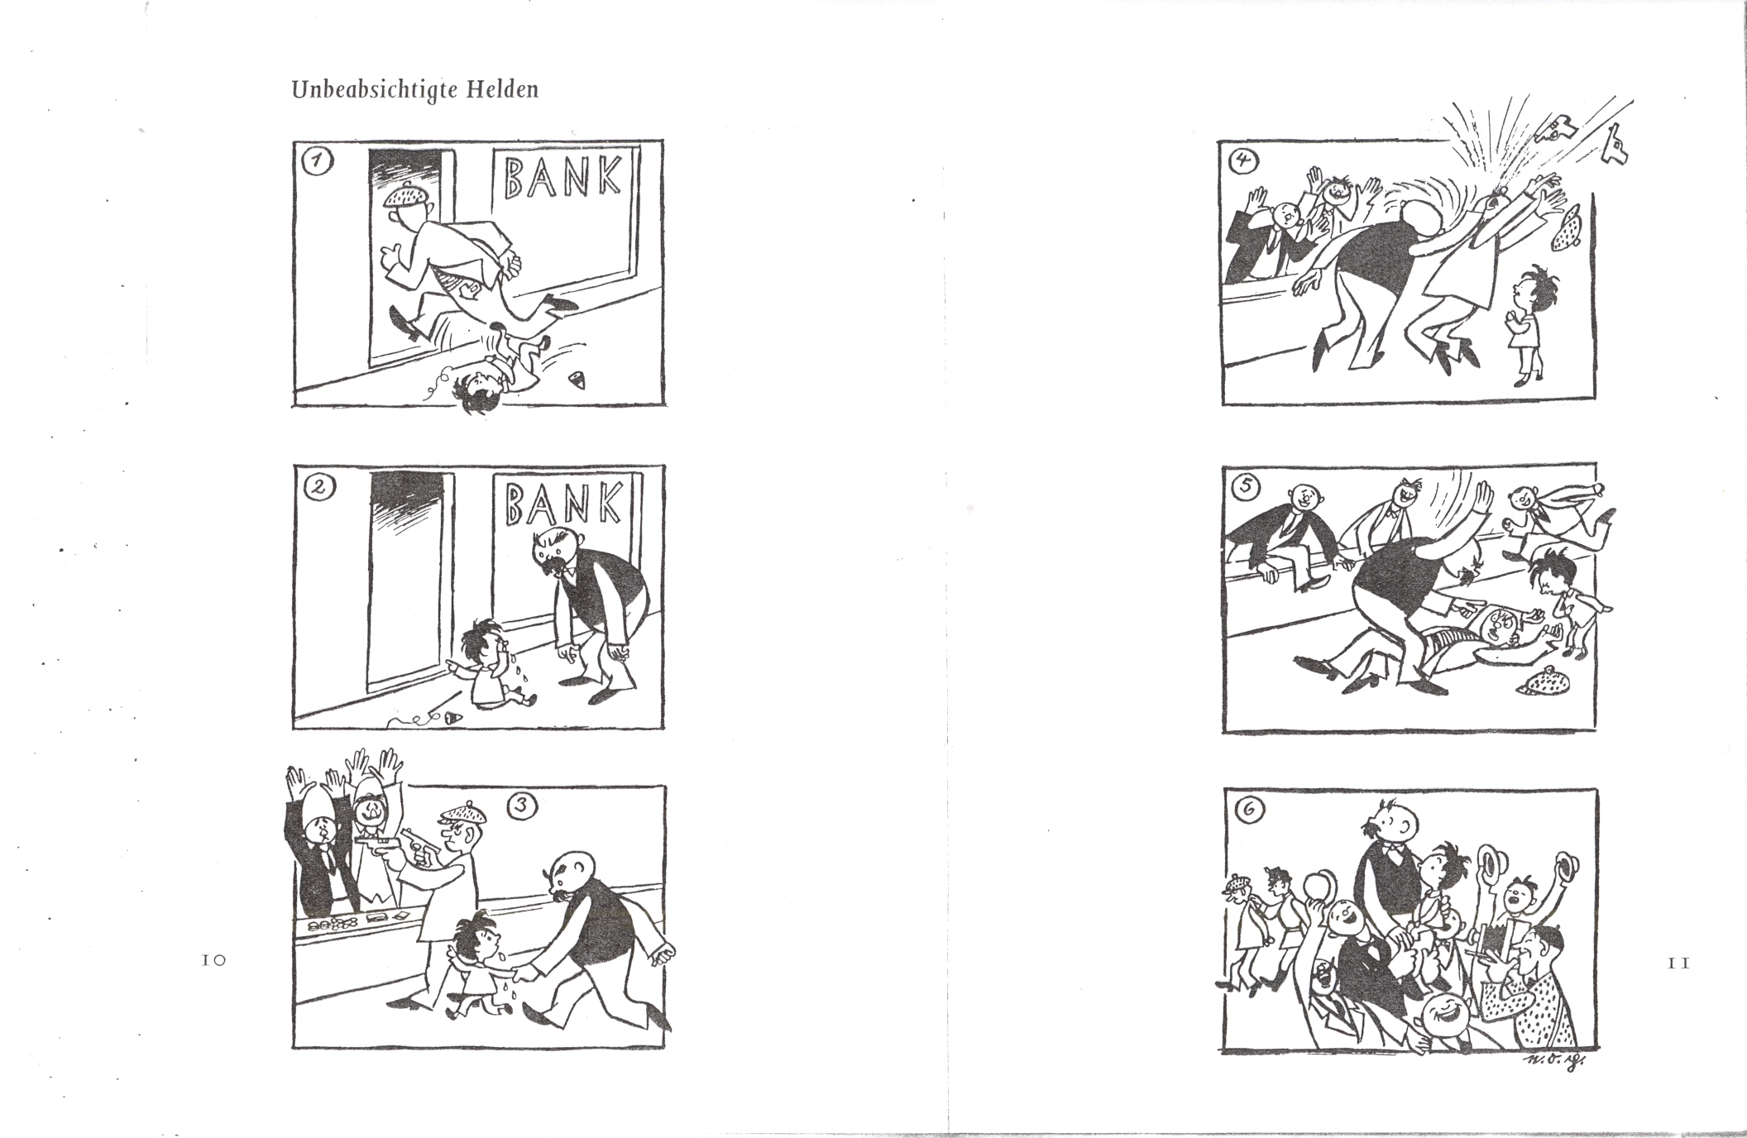
What does the man with the cap do?
Plauen, E.O. 1952] (1996). Vater und Sohn, Band 2. Ravensburger Taschenbuch

Slide 38
Overall distribution of motion verbs

Slide 39
Individual verb trajectories
Notes:
We selected verbs that were used by all three French-speaking groups, one from each type of motion verbs, and calculated how often it was used as a percentage of the total number of motion verbs used by that group. Figure 3 shows that the deictic verb aller and the manner verb courir are employed less and less frequently as language proficiency goes up, whilst the frequency of the path verb arriver and the verb of caused motion (r)amener increases. The same effect is visible in the differences in rank order of frequency of the verbs: arriver, for example, ranks fifth among the motion verbs at level one, but third at level three and it is the most frequent motion verb among the native speaker. By comparison, the manner verb courir drops in rank: at level one it is the third most frequent verb, at level three it occupies rank six and among the native speakers it is at rank nine.

Slide 40
Overall comparisons
Notes:
the level one students are significantly different from the native speakers of French (X² (1)= 7.5, p< .01), as well as from the native speakers of English (X² (1)= 36.0, p< .001) but they are not significantly different from the level three students (X² (1)= 3.08, p = .101). The level three students are also significantly different from the native speakers of English (X² (1) = 73.2, p< .001) but they are not significantly different from the native speakers of French. In other words, the level one students are still far away from the target-like expression of manner in the L2, but the level three students are more similar to native speakers of French in this respect.

Slide 41
Learnability and teachability
“Since the 1980s, discussions of effective language instruction have shifted from teacher-centred to an emphasis on learner-centred classrooms and from transmission-oriented to participatory or constructivist knowledge development.” Crandall (1999: 226; in Grundy 1999)
But how can the learning process be assisted in the classroom?
Notes:
Frustration with endless tests – move towards interventions

Slide 42
Further research
Frequency in the input?
Which students are able to reconceptualise motion, which ones continue to use transfer strategies ?
Is success related to language proficiency scores or to noticing skills?
How can we help learners to progress?

Slide 43
Strategies for developing vocabulary
“In addition to incidental learning of vocabulary through oral language and reading experience, children learning EAL need opportunities for explicit learning and teaching of new vocabulary across the curriculum and throughout the primary years in order to learn new vocabulary (…)”
Source: National strategy EAL resources
EAL toolkit 2. Excellence and enjoyment: learning and teaching for bilingual children in the primary years. http://www.wokingham.gov.uk/schools/wslc/school-learning-community/teaching-and-learning/whole-school-issues/eal/english-as-an-additional-language/national-strategy-eal-resources/bilingual/

Slide 44
Strategies for teaching keywords (EAL children)
Personal wordbooks in which pupils record words as they are introduced to them. Pupils can draw pictures, write a definition in the first language or in English, or write a sentence including the word to help them to remember the meaning.
Pupil labels pictures using a bilingual picture dictionary
Word searches - with definition (www.puzzlemaker.com)
Gap fill sentences
Matching words and pictures
Word bingo – TA reads definitions and the pupil crosses out the words on a card
Source: Wokingham learning hub

Slide 45
Conclusion: towards intervention studies
Meta analysis of existing intervention studies
  Norris and Ortega (2000)
  Marulis and Neuman (2010)
What are the gaps in our knowledge?
More knowledge exchange between researchers and teachers
Towards evidence-based interventions
Notes:
Pre-school children’s oral language development benefited strongly from interventions
Explicit instruction better than implicit learning
Instruction followed by meaningful practice and review: most effective

Slide 46


Slide 47
References
Aitchison, J. (2003). Words in the mind. An introduction to the mental lexicon. Oxford: Blackwell.
Bialystok, E., Luk, G., Peets, K.F., & Yang, S. (2010). Receptive vocabulary differences in monolingual and bilingual children. Bilingualism: Language and Cognition, 13, 525–531.
D'Anna, C.A., Zechmeister, E.B., & Hall, J.W. (1991). Toward a meaningful definition of vocabulary size. Journal of Reading Behavior, 23, 109-122.
Duke, N., K., & Carlisle, J. (2011). The development of comprehension. In M. Kamil, P. D. Pearson, E. B. Moje, & P. P. Afflerbach (Eds.), Handbook of reading research (Vol. 4, pp. 199-228). New York: Routledge.
Goulden, R., Nation, P., & Read, J. (1990). How large can a receptive vocabulary be? Applied Linguistics, 11 (4), 341-363.
HARTMANN, GEORGE W. 1946. "Further Evidence on the Unexpected Large Size of Recognition Vocabularies among College Students." Journal of Educational Psychology 37:436–439.
Kirkpatrick, E.A. (1891). The number of words in an ordinary vocabulary. Science 18 (446), 107-108.

Slide 48
Macaro, E. (2003). Teaching and Learning a Second Language: A Review of Recent Research. London: Continuum
Marulis , L.M. & Neuman, S. B. (2010). The Effects of Vocabulary Intervention on Young Children’s Word Learning: A Meta-Analysis. Review of Educational Research, 80 (3), pp. 300-335.
McLeod, S. (2010). Laying the foundations for multilingual acquisition. An international overview of speech acquisition. In M. Cruz-Ferreira (Ed). Multilingual norms (pp. 53-71). Frankfurt: Peter Lang Publishing.
Milton, J. (2009). Measuring second language vocabualry acquisition. Bristol: Multilingual Matters.
Milton, J & Treffers-Daller, J. (in prep.). Vocabulary size revisited.

Slide 49
Nagy, W. (1988). Teaching vocabulary to improve reading comprehension. Urbana, IL: National Council of Teachers of English.
Nagy, W. E. &Herman, P. A. (1987). Breadth and depth of vocabulary knowledge: implications for acquisition and instruction. In McKeown, M. G. and M. E. Curtis. (Eds.). The Nature of Vocabulary Acquisition. Lawrence Erlbaum Associates (pp.19-35). Hillsdale: New Jersey.
Norris, J. M., & Ortega, L. (2000). Effectiveness of L2 instruction: A research synthesis and quantitative meta-analysis. Language Learning 50, 417-528.
Seashore, R. & L. Eckerson (1940). The measurement of individual differences in general English vocabularies. Journal of Educational Psychology 31, 14-38.

Slide 50
Treffers-Daller, J. (accepted pending revisions). Can L2 learners learn new ways to conceptualise events? Evidence from motion event construal among English-speaking learners of French. In P. Gujarro-Fuente, N. Müller & K. Schmitz (Eds.), The acquisition of French in its different constellations. Clevedon: Multilingual Matters.
White, T. G., Graves, M. F., & Slater, W. H. (1990). Growth of reading vocabulary in diverse elementary schools: Decoding and word meaning. Journal of Educational Psychology, 82, 281-290

Slide 51
Web resources
The Haldane Principle. Government position December 2010. http://www.bis.gov.uk/assets/biscore/science/docs/a/10-1356-allocation-of-science-and-research-funding-2011-2015.pdfLiteracy Trust.
Wokingham Learning Hub: new arrivals with English as an additional language: a toolkit for primary schools.
http://www.school-portal.co.uk/GroupHomepage.asp?GroupID=974569
Bilingual children in the primary years. EAL toolkits
http://www.wokingham.gov.uk/schools/wslc/school-learning-community/teaching-and-learning/whole-school-issues/eal/english-as-an-additional-language/national-strategy-eal-resources/
Ethnic Minority Achievement Service (EMAS) www.EMAS4success.org

