Slide 1
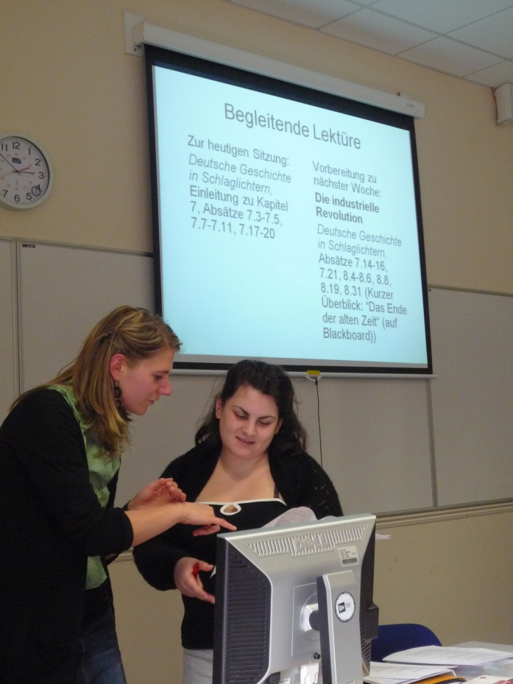
Integrating Content and Language: An alternative approach to undergraduate language teaching and learning
LLAS Conference 5-6 July, 2012
Elisabeth Wielander, Aston University

Slide 2
Outline
What is CLIL?
Overview of research into CLIL
CLIL in Higher Education
PhD project: case study
Conclusion and outlook

Slide 3
Defining CLIL
Within CLIL, language is used as a medium for learning content, and the content is used in turn as a resource for learning languages.
European Commission (2005: 2)

Slide 4
Defining CLIL
Content and Language Integrated Learning (CLIL) is a dual-focused educational approach in which an additional language is used for the learning and teaching of both content and language. That is, in the teaching and learning process, there is a focus not only on content, and not only on language. Each is interwoven, even if the emphasis is greater on one or the other at a given time.
Do Coyle et al. (2010: 1)

Slide 5
Immersion education
native-like receptive skills
oral and written production somewhat less developed
overall higher levels of proficiency
performance in the subject matter taught through L2 comparable to non-lingual peer groups
decidedly positive attitude towards L2 and its speakers
Pérez-Caňado 2012: 317

Slide 6
CLIL in Higher Education
The study of languages at university level is a multidisciplinary learning process, allowing access to a broad range of enquiries, including linguistic, literary, cultural, social, political and historical studies.
(Quality Assurance Agency for Higher Education, Subject Benchmark Statement: Languages and related studies 2007: 6)

Slide 7
CLIL at Aston
all language and content modules are taught in the foreign language from Year 1
40-80 out of 120 credits taught AND assessed through MFL
integrated Year Abroad after 2 years of study
language modules interlink with content modules to support linguistic and academic requirements of the CLIL classroom

Slide 8
Example: Marking criteria
Notes:
For Language Modules, a weighting of approx. 60% for language and 40% for content applies
For Content Modules, a weighting of approx. 60% for content and 40% for language applies

Slide 9
Example: Marking criteria

Slide 10
Question C3, round 1
n=60

Slide 11
Question C4, round 1
n=60

Slide 12
Question B5, round 1
n=60

Slide 13
Question D20: I consider using German to communicate in class a beneficial and rewarding challenge.
Round 1:
Round 2:
n=60
n=58
Notes:
D18: I believe that I would retain more information if I was taught in English. The students’ attitude is quite clear: Of 60 students asked in round 1, only 15 agree with this statement, whereas a clear majority of 75% disagrees.

Slide 14
Question D 26: I believe that, without the Integrated Approach, my language skills would not have improved as significantly as they have.
Round 1:
Round 2:
n=37
n=35

Slide 15
Year 2: Question D 30 I feel more comfortable about going abroad next year because I have got used to using German to communicate in and out of class.
Round 1:
Round 2:
n=20
n=17

Slide 16
Year F: Question D 30
n=17

Slide 17
LanQua – Language Network for Quality Assurance
three-year project to ‘map the current landscape for languages in higher education’ (LanQua 2010a)
based at the LLAS Subject Centre at the University of Southampton in cooperation with the Lifelong Learning Erasmus Network and partly funded by the European Commission
CLIL = ‘umbrella term for all those HE approaches in which some form of specific and academic language support is offered to students in order to facilitate their learning of the content through that language’
(LanQua 2010b)

Slide 18
LanQua – Language Network for Quality Assurance
(source: Greere / Räsänen 2008: 6)

Slide 19
CLIL training
It seems that CLIL at the tertiary level is often performed in a rather casual manner because university professors are not inclined to receive training on how to teach in a foreign language.
(Costa / Coleman 2010: 26)
CLIL training specially adapted to university teachers is necessary so that lecturers can overcome their reluctance to a methodological training and thereby the potential of CLIL is realised.
(Aguilar / Rodriguez 2012: 183)

Slide 20
CLIL as solution
Successful employability of today’s higher education (HE) graduates in Europe is more and more dependent on how well they are prepared linguistically and interculturally to enter the internationalised labour market.
(Greere / Räsänen 2008: 3)

Slide 21
Contact details:
Elisabeth Wielander
e.wielander@aston.ac.uk
School of Languages and Social Sciences
Thank you!

